Slide 1
Mitochondria
Testing and Optimization
Life and Death
Marc Harris N.D.

Slide 2



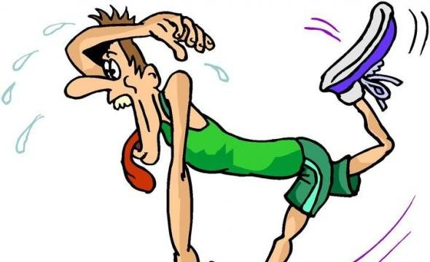
Fitness

Slide 3
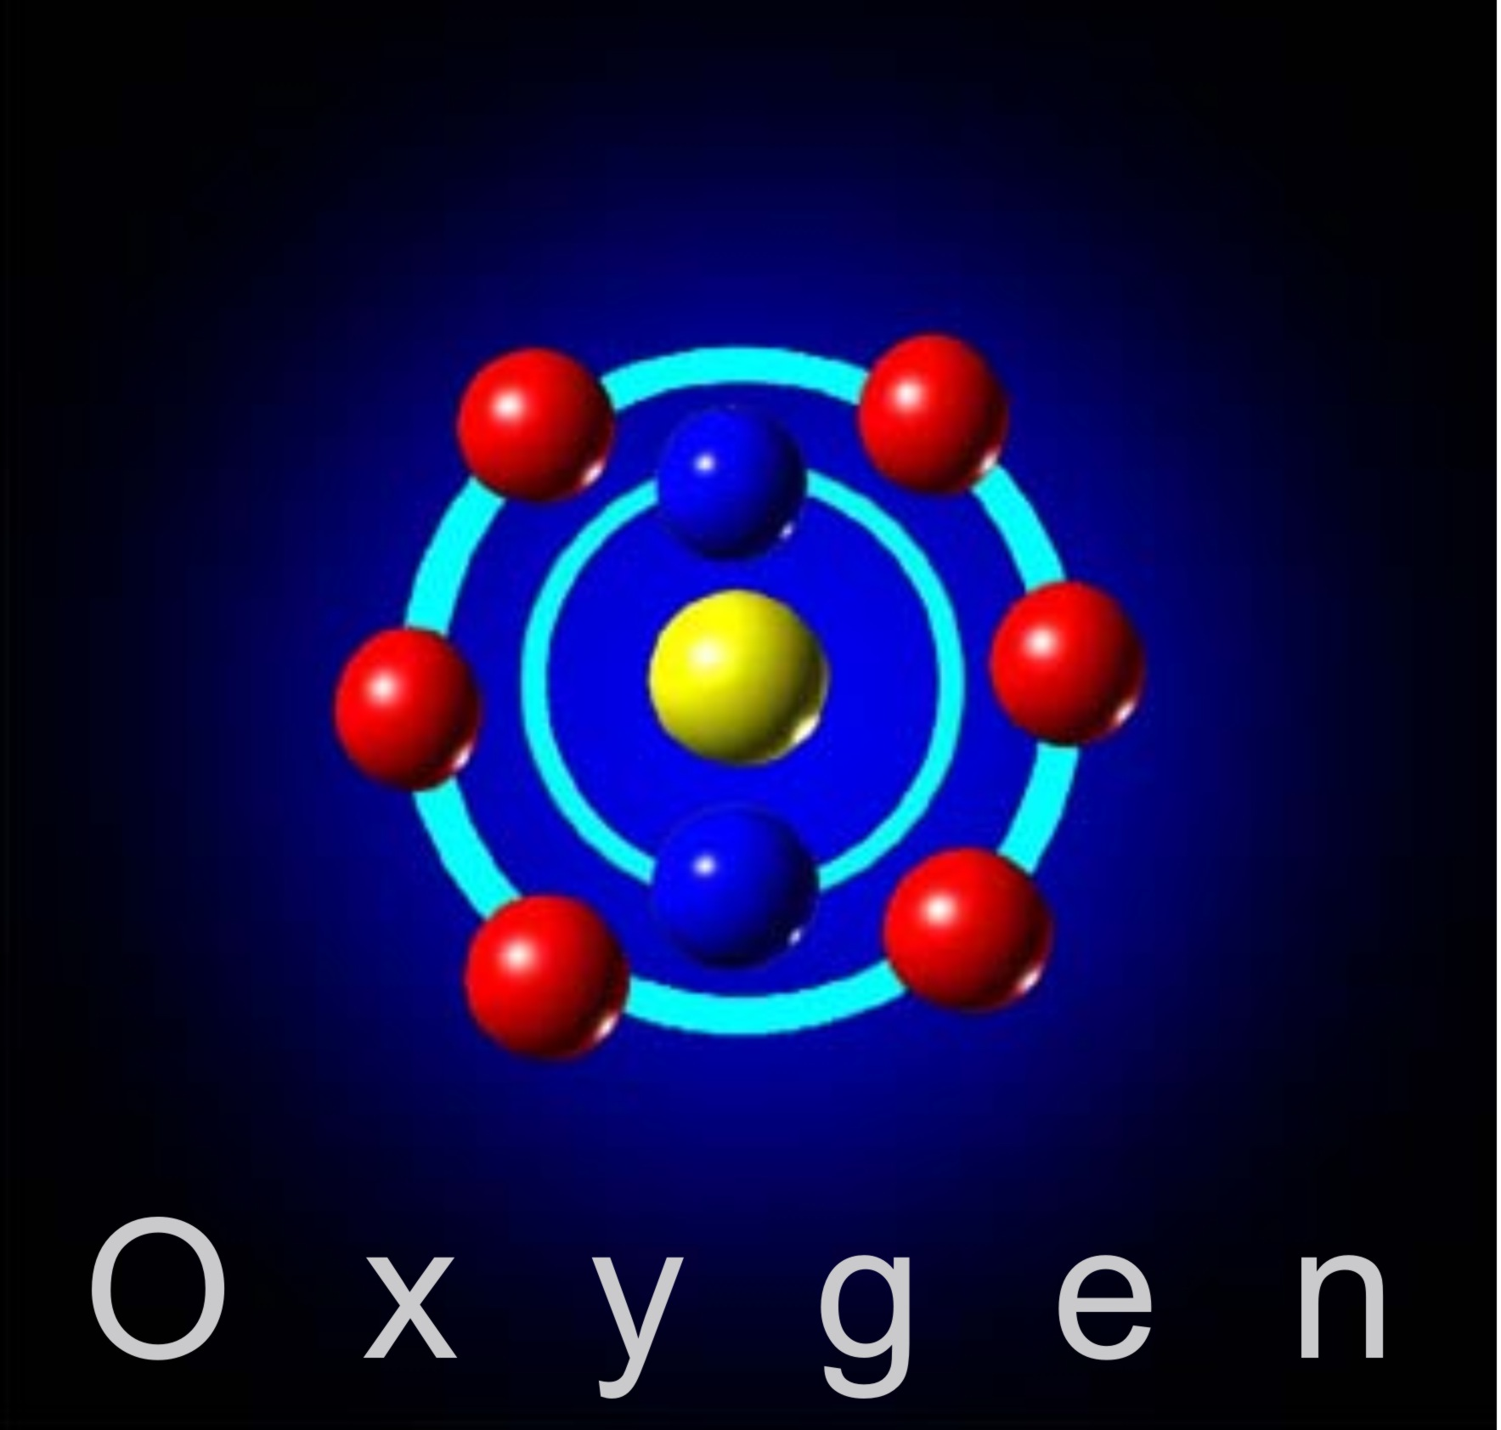
Fitness

Slide 4
Cancer
Somatic Mutation Theory (SMT)
Mutation
Uncontrolled growth
Death

Slide 5
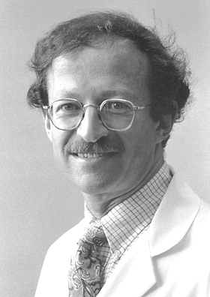
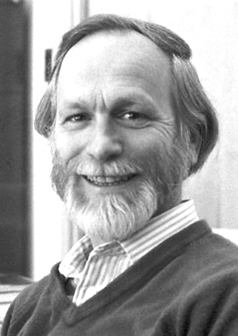
Is it a virus?
RSV
Harold Varmus
David Bishop

Slide 6

Emperor of all Maladies
Siddhartha Mukherjee
PBS series
Time magazine

Slide 7
“Cancer, we now know, is a disease caused by the uncontrollable
growth of a single cell. This growth is unleashed by mutations-changes
in DNA that specifically affect genes that incite unlimited cell growth.
In a normal cell, powerful genetic circuits regulate cell division and cell death.
In a cancer cell, these circuits have been broken, unleashing a cell that cannot stop growing.”

Slide 8
Continued
“Cancer is stitched into our genomes…We can
rid ourselves of cancer, then, only as much as
we can rid ourselves of the process in our
physiology that depends on growth - aging,
regeneration,healing, reproduction...It is unclear
whether an intervention that discriminates
between malignant and normal growth is even
possible.”

Slide 9
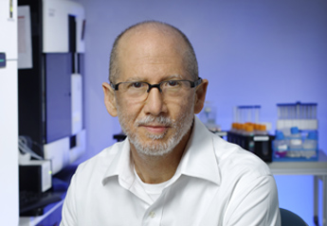
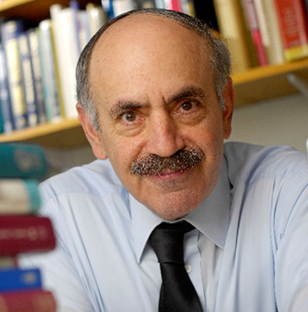
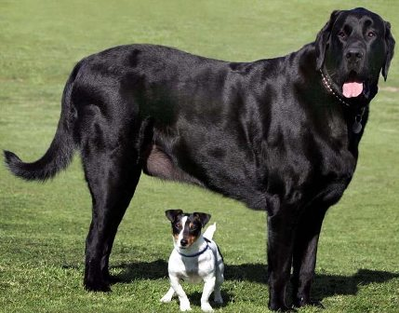
Big Dogs SMT
Bert Vogelstein Ph.D.
Robert Weinberg Ph.D.

Slide 10
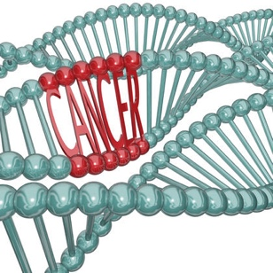
Vogelstein
J Am Coll Surg. 1999 Jan;188(1):74-9.
Genetic testings for cancer: the surgeon's critical role. Familial colon cancer.
Vogelstein B
Cell. 1994 Oct 7;79(1):1-3.
Has the breast cancer gene been found?
Vogelstein B, Kinzler KW
Genome Res. 2007 Sep;17(9):1304-18. Epub 2007 Aug 10.
A multidimensional analysis of genes mutated in breast and colorectal cancers.
Lin J1, Gan CM, Zhang X, Jones S, Sjöblom T, Wood LD, Parsons DW, Papadopoulos N, Kinzler KW, Vogelstein B, Parmigiani G, Velculescu VE.

Slide 11
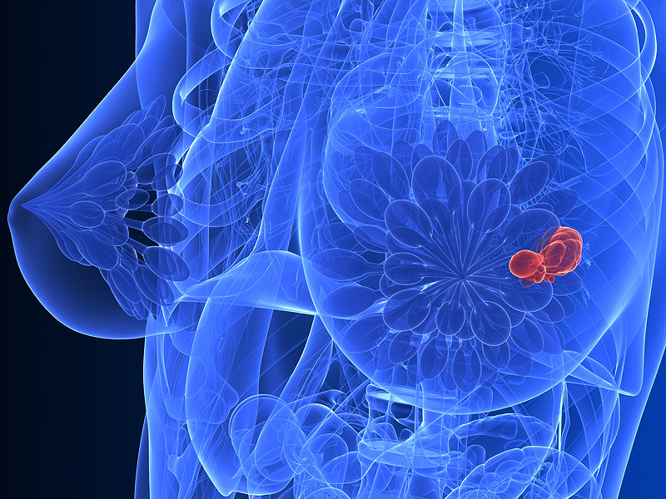
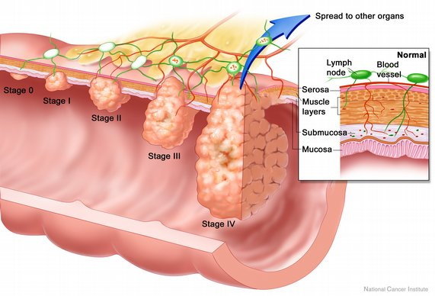
Proc Natl Acad Sci U S A. 2008 Oct 21;105(42):16224-9. doi: 10.1073/pnas.0808041105. Epub 2008 Oct 13.
Integrated analysis of homozygous deletions, focal amplifications, and sequence alterations in breast and colorectal cancers.
Leary RJ1, Lin JC, Cummins J, Boca S, Wood LD, Parsons DW, Jones S, Sjöblom T, Park BH, Parsons R, Willis J, Dawson D, Willson JK, Nikolskaya T, Nikolsky Y, Kopelovich L, Papadopoulos N, Pennacchio LA, Wang TL, Markowitz SD, Parmigiani G, Kinzler KW, Vogelstein B, Velculescu VE.
An integrated genomic analysis of human glioblastoma multiforme.
Parsons DW, Jones S, Zhang X, Lin JC, Leary RJ, Angenendt P, Mankoo P, Carter H, Siu IM, Gallia GL, Olivi A, McLendon R, Rasheed BA, Keir S, Nikolskaya T, Nikolsky Y, Busam DA, Tekleab H, Diaz LA Jr, Hartigan J, Smith DR, Strausberg RL, Marie SK, Shinjo SM, Yan H, Riggins GJ, Bigner DD, Karchin R, Papadopoulos N, Parmigiani G, Vogelstein B, Velculescu VE, Kinzler KW.
Science. 2008 Sep 26;321(5897):1807-12. doi: 10.1126/science.116438
Transcriptional regulation of basic fibroblast growth factor gene by p53 in human glioblastoma and hepatocellular carcinoma cells.
Ueba T, Nosaka T, Takahashi JA, Shibata F, Florkiewicz RZ, Vogelstein B, Oda Y, Kikuchi H, Hatanaka M.
Proc Natl Acad Sci U S A. 1994 Sep 13;91(19):9009-13

Slide 12
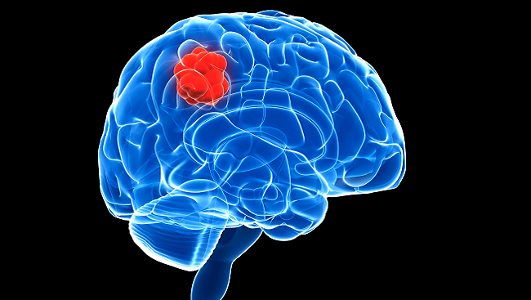
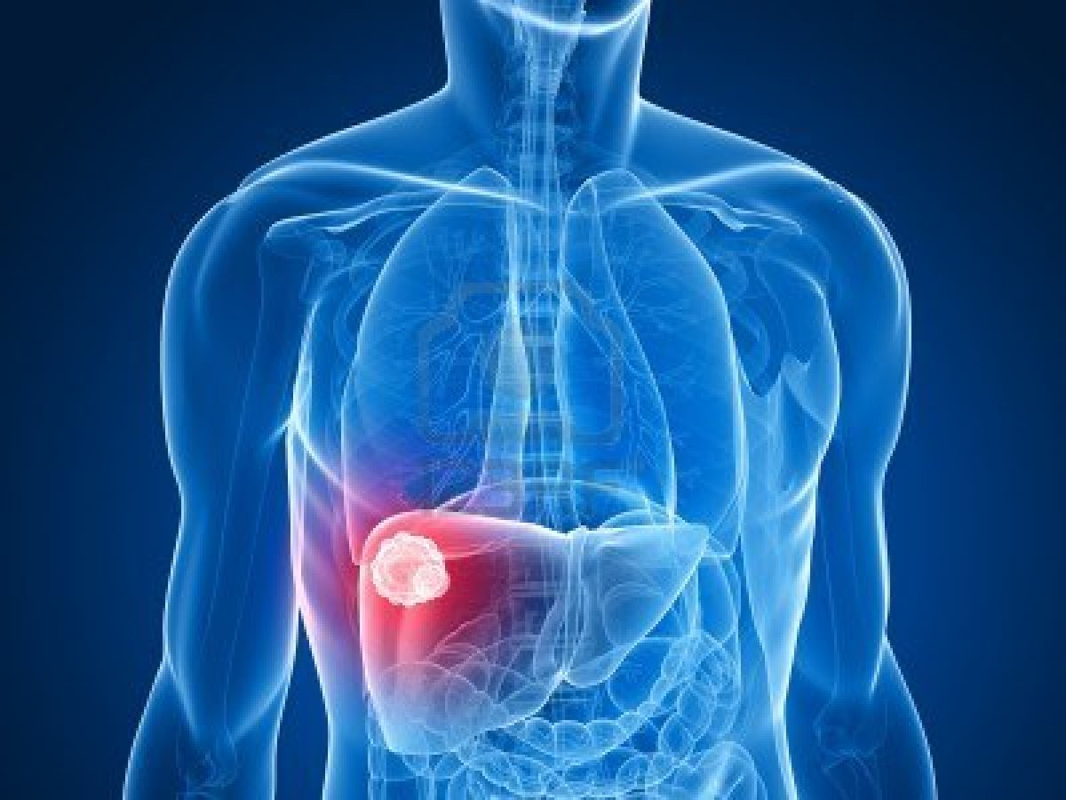
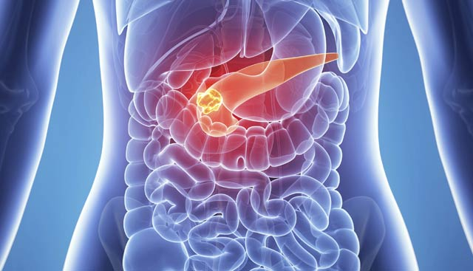

Slide 13
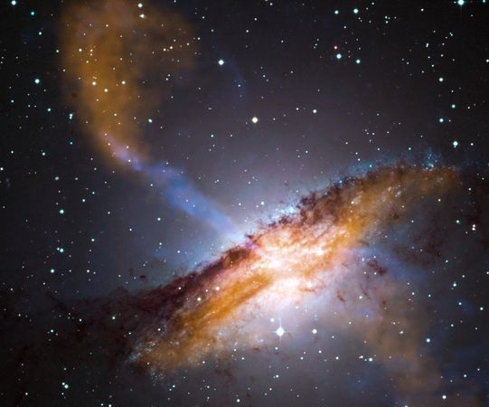
Universe

Slide 14
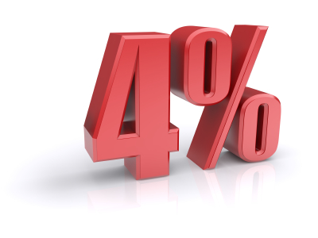
Energy
E of the universe E^{U}
Energy of the Stars E^{S}
E^{S +} ? = E^{U}
Dark Energy E^{D}

Slide 15
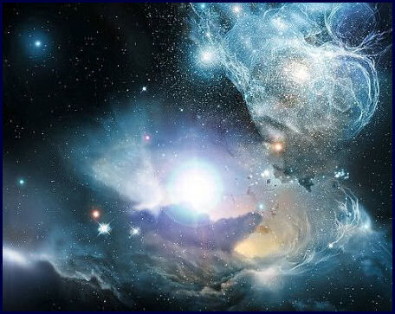
Energy?
E^{D}

Slide 16
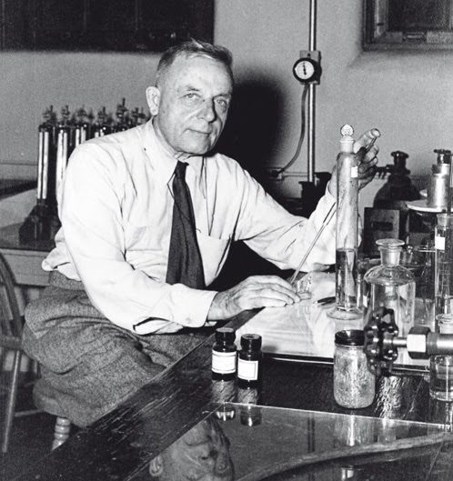
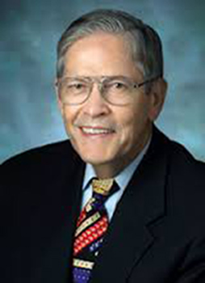
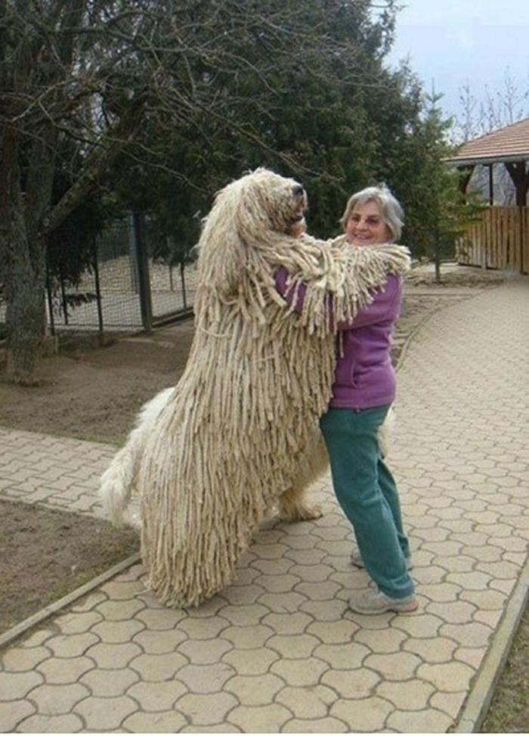
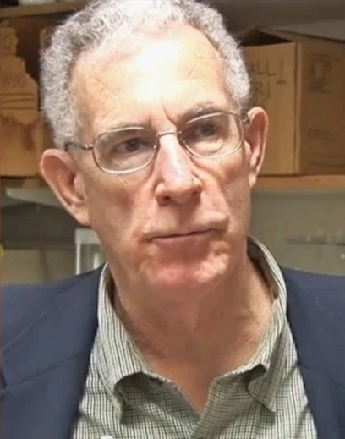
More Big Dogs
Otto Warburg Ph.D.
Peter Petersen Ph.D.
Thomas Seyfried Ph.D.

Slide 17
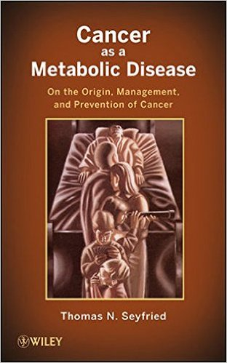

Slide 18
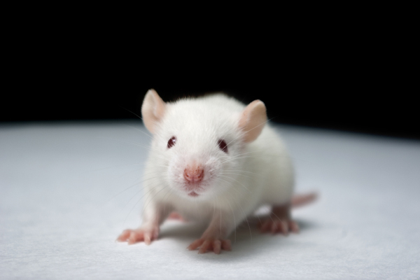
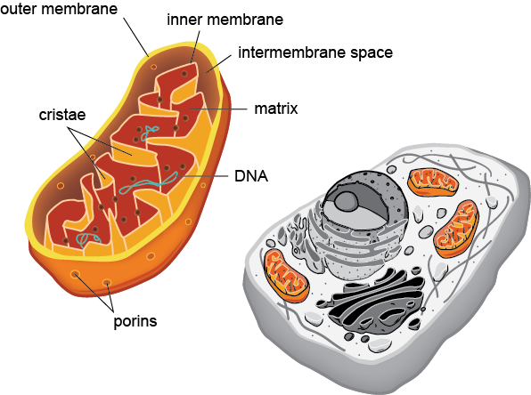
Paradigm shift
In Vitro Cellular & Developmental Biology
September 1987, Volume 23, Issue 9, pp 627–632
Cytoplasmic suppression of malignancy
Barbara A. Israel, Warren I. Schaeffer
Cancer Research
Cytoplasmic Suppression of Tumorigenicity in Reconstructed Mouse Cells
Jerry W. Shay and Harold Werbin
Published 15 February 1988
FASEB J. 2016 Apr;30(4):1377-9. doi: 10.1096/fj.16-0401ufm.
Fueling Cancer: Glucose, Again.
Pederson T.

Slide 19
Autoimmune
Cardiovascular
Telomeres
Respiratory
Mitochondrial Discrepancy
Structural
Digestive
Neural
Renal
Emotional
Endocrine

Slide 20
2008-2009 Presidents Cancer Panel

Slide 21
Blue Ribbon Panel Report
A. Establish a network for direct patient involvement in cancer research.
B. Create a translational network devoted exclusively to immunotherapy.
C. Develop ways to overcome resistance to therapy.
D. Build a national cancer data ecosystem.
E. Intensify research on the major drivers of childhood cancers.
F. Minimize cancer treatment’s debilitating side effects.
G. Expand use of proven prevention and early detection strategies.
H. Mine past patient data to predict future patient outcomes.
I. Develop a 3D cancer atlas.
J. Develop new cancer technologies.

Slide 22
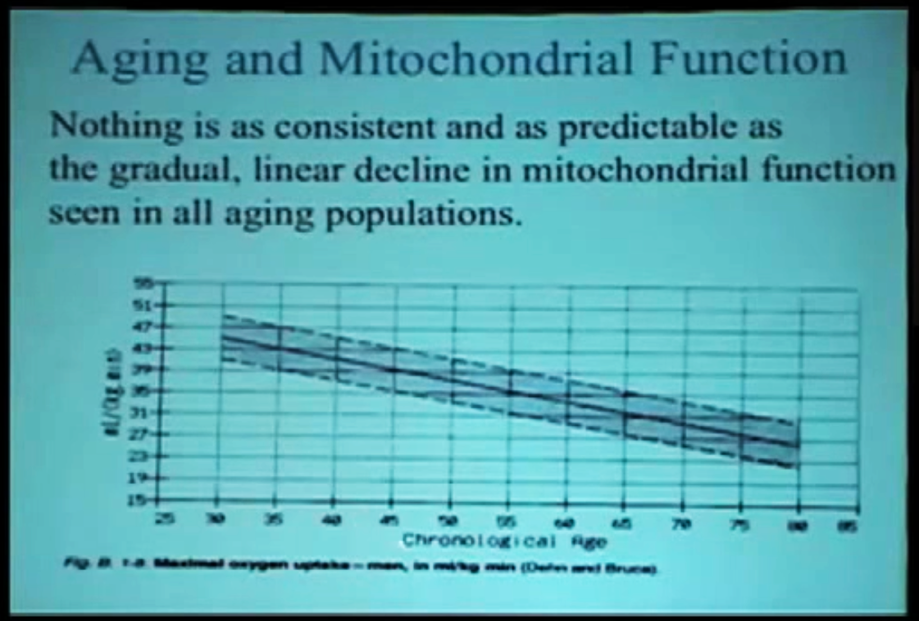
Mitochondrial Decline
10 % per decade

Slide 23
Mitochondrial Math
C6H12O6 + 6 O2 >> 6 CO2 + 6 H2O + 38 ATP
(Glucose)
C6H12O6 + 2 ADP >> 2 H+ 2 H2O + 2 ATP + lactic acid
(Glucose)
C16H32O2 + 23 O2 >> 16 CO2 + 16 H2O + 129 ATP
Fatty acid
RER = V(CO2)/V(O2)

Slide 24
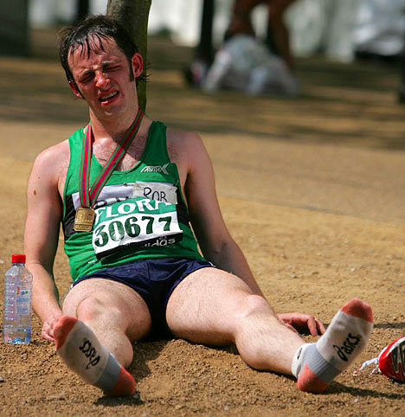

Slide 25
Stages of Decline
Anaerobic
Anaerobic
Carb
Anaerobic
Carb
Anaerobic
Carb
Fat
Carb
Fat
Fat
Fat

Slide 26
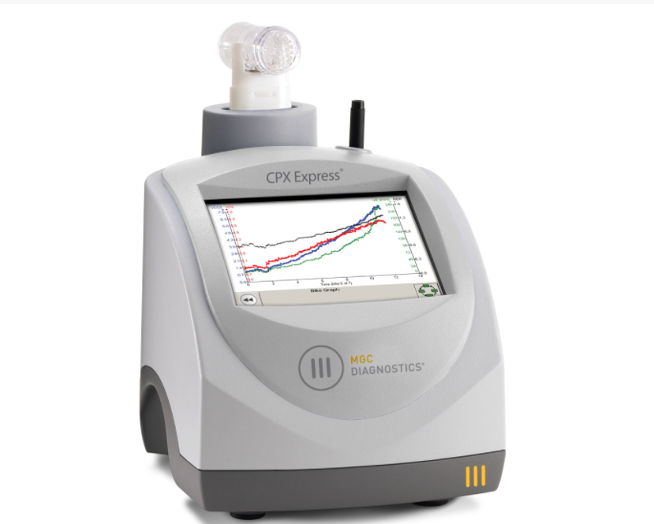
Mitochondrial Testing

Slide 27
Patient History
Age: 59
Fatigued
Muscle pain (the usual)
Insomnia

Slide 28
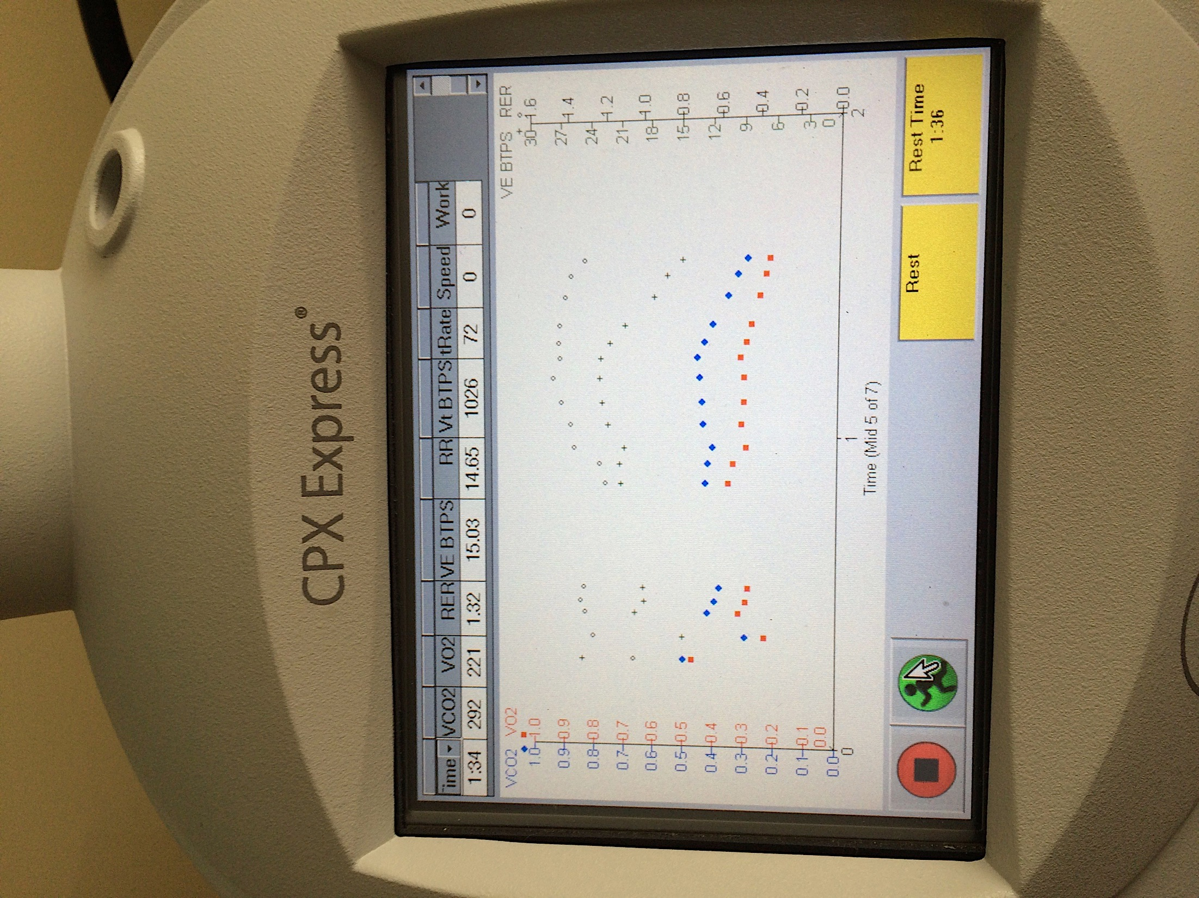
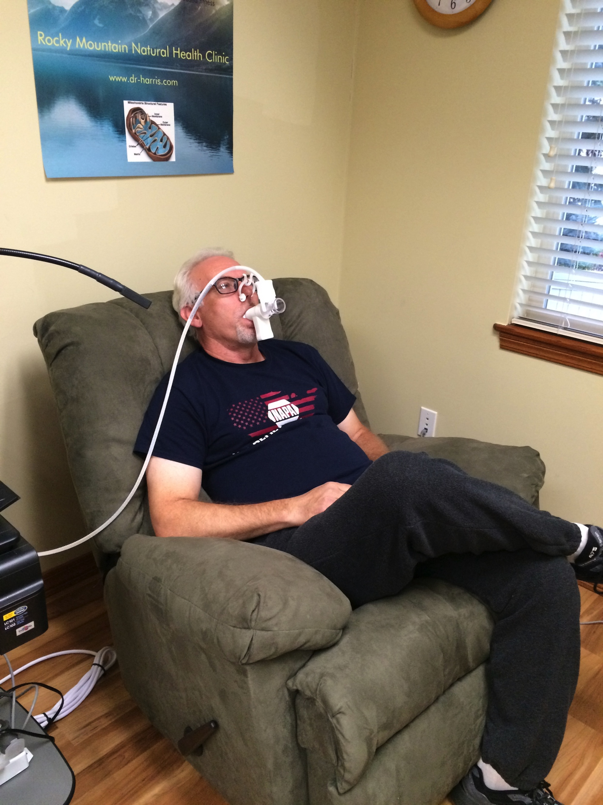
Stationary Testing

Slide 29
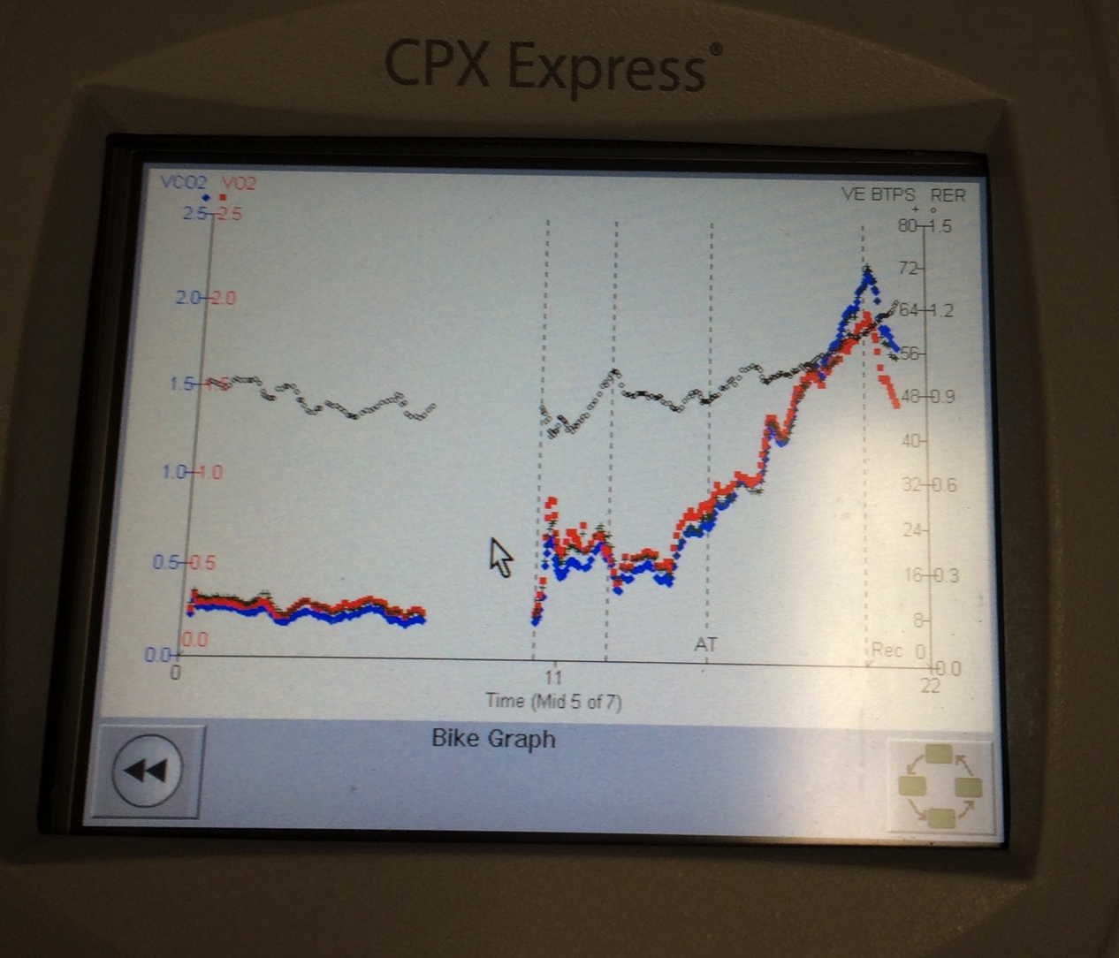
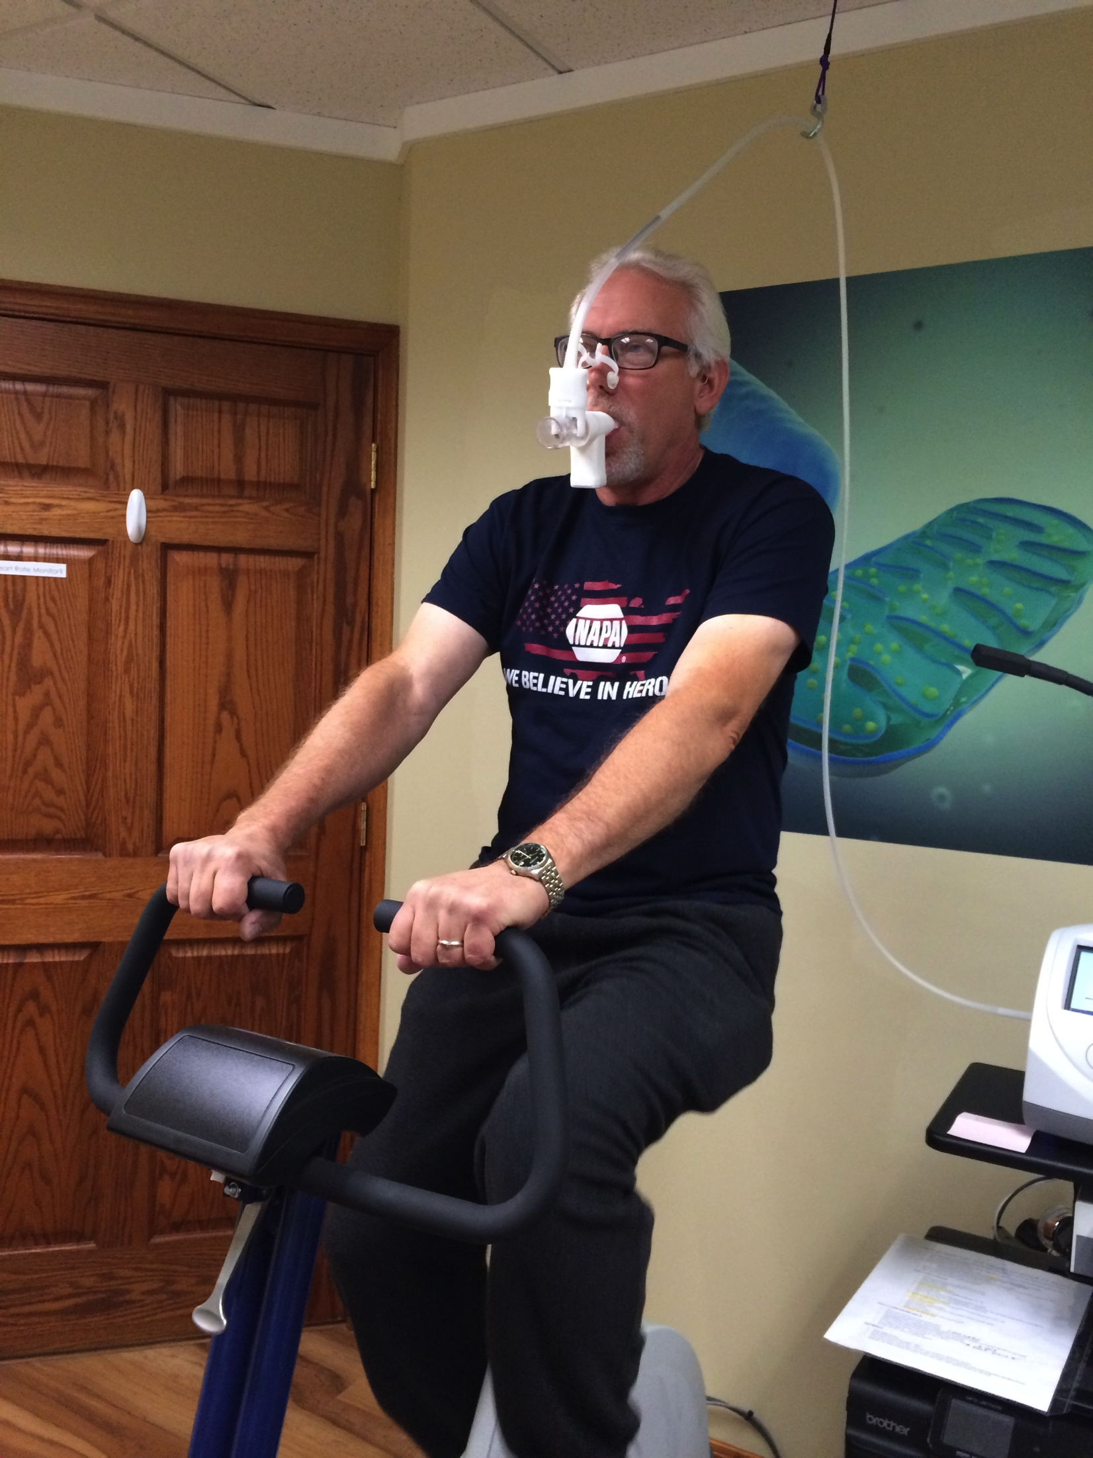
Exercise Testing

Slide 30
JL Age 59 4/11/2016
Chief concerns: Fatigue, Fibromyalgia, Depression, Insomnia
Measure | Optimal
Resting heart rate: 90 | < 75
Resting Respiratory Rate: 9 | <15
Breathing factor: 117 | 100-115
Adrenal Factor: 89 | >100
Lung Factor: 89 | >100
Fitness Factor: 63 | >100
M Factor: 76 | 100-120
C Factor: 50 | >100
Fat Burning factor: 40 | >100
Energy Quotient: 73 | >100
Biological Age: 80 | Chronological age: 59
Methylation Factor 8 | >100

Slide 31
JL Age 59 06/15/2016
Chief concerns: Fatigue, Fibromyalgia, Depression, insomnia: all resolving
Measure | Optimal
Resting heart rate: 80 | < 75
Resting Respiratory Rate: 9 | <15
Breathing factor: 117 | 100-115
Adrenal Factor: 100 | >100
Lung Factor: 95 | >100
Fitness Factor: 80 | >100
M Factor: 86 | 100-120
C Factor: 75 | >100
Fat Burning factor: 80 | >100
Energy Quotient: 88 | >100
Biological Age: 63 | Chronological age: 59
Methylation Factor 54 | >100

Slide 32
JL Age 59 09/26/2016
Chief concerns: None
Measure | Optimal
Resting heart rate: 60 | < 75
Resting Respiratory Rate: 7 | <15
Breathing factor: 117 | 100-115
Adrenal Factor: 110 | >100
Lung Factor: 106 | >100
Fitness Factor: 116 | >100
M Factor: 109 | 100-120
C Factor: 104 | >100
Fat Burning factor: 111 | >100
Energy Quotient: 107 | >100
Biological Age: 46 | Chronological age: 59
Methylation Factor: 123 | >100

Slide 33
BL age 72 2004
Health concerns: none
Measure | Optimal
Resting heart rate: 58 | < 75
Resting Respiratory Rate: 10 | <15
Breathing factor: 120 | 100-115
Adrenal Factor: 106 | >100
Lung Factor: 99 | >100
Fitness Factor: 120 | >100
M Factor: 130 | 100-120
C Factor: 114 | >100
Fat Burning factor: 126 | >100
Energy Quotient: 119 | >100
Biological Age: 40 | Chronological age: 72
Methylation Factor: 116 | >100

Slide 34
BL age 73-81 2005-2014
Health concerns: none
Results unchanged

Slide 35
BL age 82 2014
Health concerns: SOB, joint pain, memory problems
Measure | Optimal
Resting heart rate: 75 | < 75
Resting Respiratory Rate: 16 | <15
Breathing factor: 70 | 100-115
Adrenal Factor: 68 | >100
Lung Factor: 96 | >100
Fitness Factor: 81 | >100
M Factor: 77 | 100-120
C Factor: 70 | >100
Fat Burning factor: 64 | >100
Energy Quotient: 70 | >100
Biological Age: 90 | Chronological age: 82
Methylation Factor: 40 | >100

Slide 36
Extra Mitochondrial Factors
Lungs
Heart
Arteries
Cell membranes

Slide 37
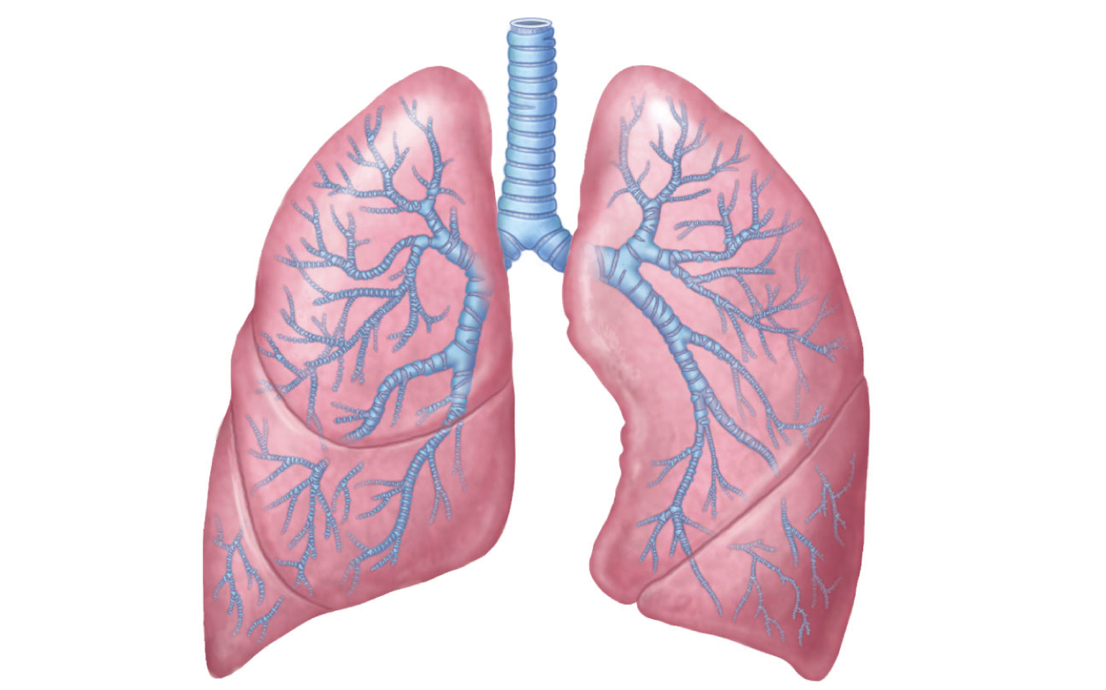
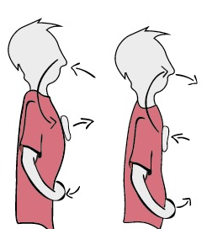
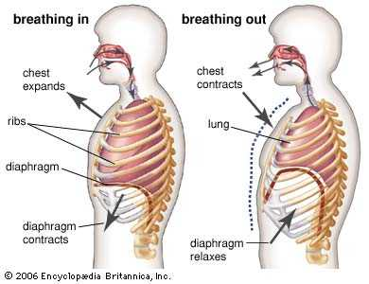
Lungs
Asthma
COPD
Bronchi
Infection
Breathing

Slide 38

Heart
CHF
Arrhythmias
V Tac
MI
Angina
Smoking
Physical inactivity

Slide 39
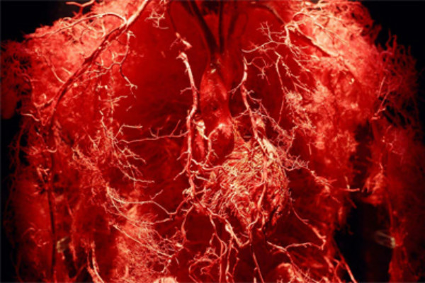
Arterial
Hypertension
Calcification
Plaque deposits
AGE’s

Slide 40
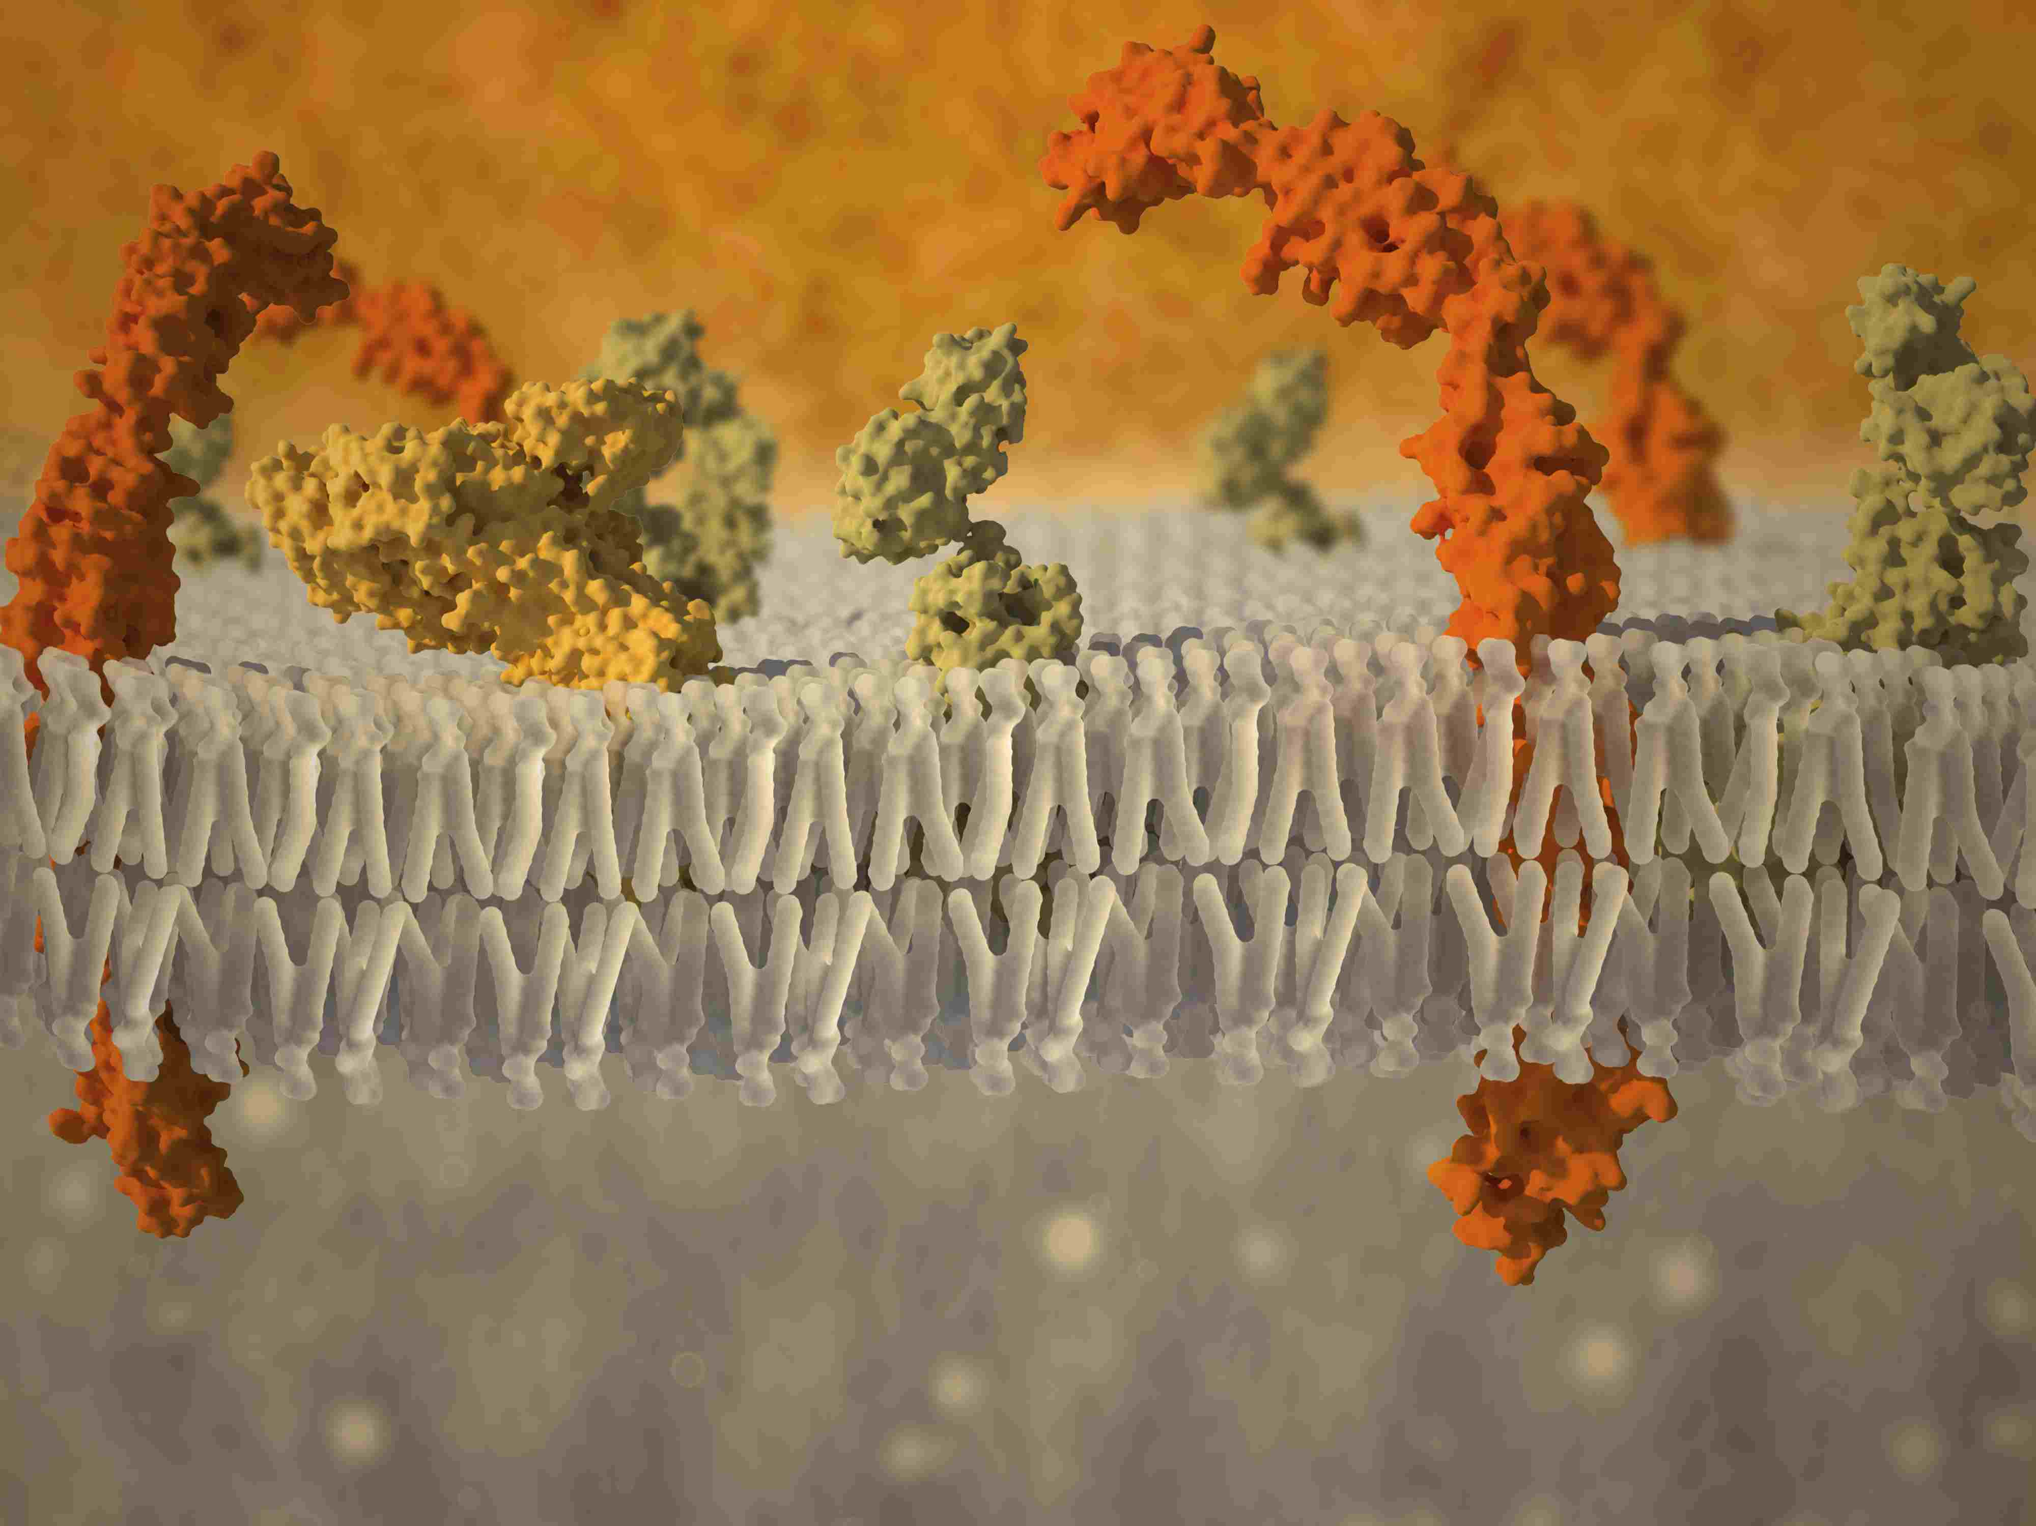
Cellular Membranes
Cellular flexibility

Slide 41
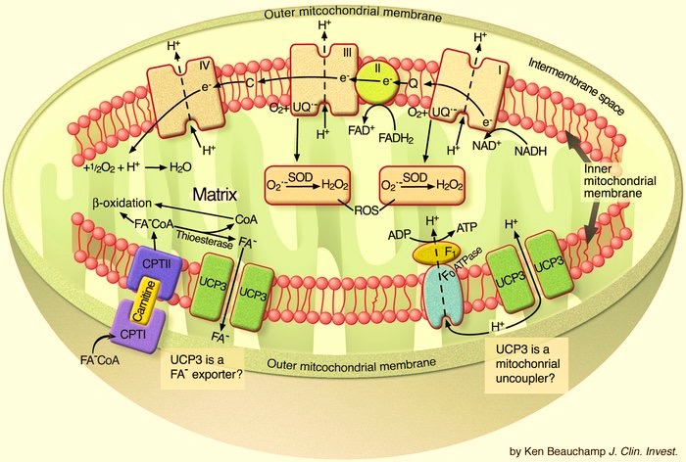
Uncouplers

Slide 42
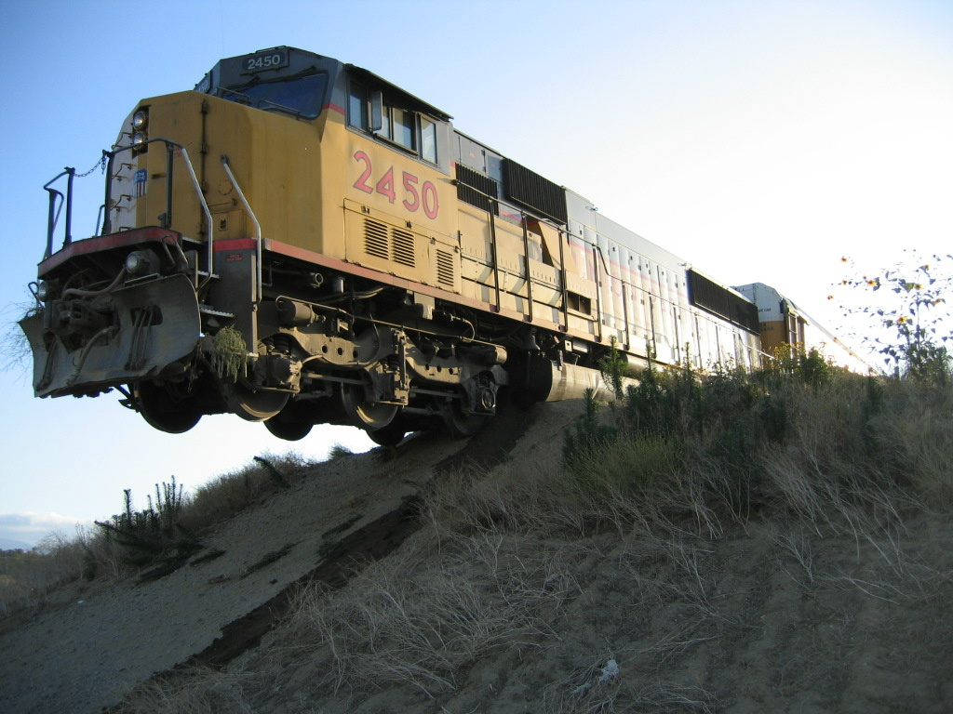
Exogenous Uncouplers

Slide 43
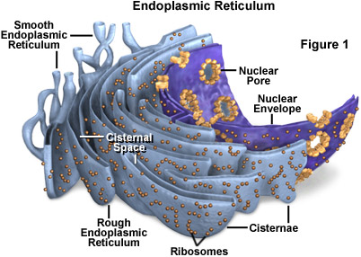
Mitochondrial Toxins
NSAID’s
Antibiotics
Steroids
Chemotherapy
Metformin
Beta Blockers
Vaccines
Valproic acid
Antivirals
Biotoxins
Mycotoxins
Bacteria
Fungal
PAH’s
Hydrocarbons
Glyphosate
Paraquat
4HNE
Cyanide
Lead
Mercury
Arsenic
Manganese
Sulfites
Bromine
Fluorine
Chlorine

Slide 44
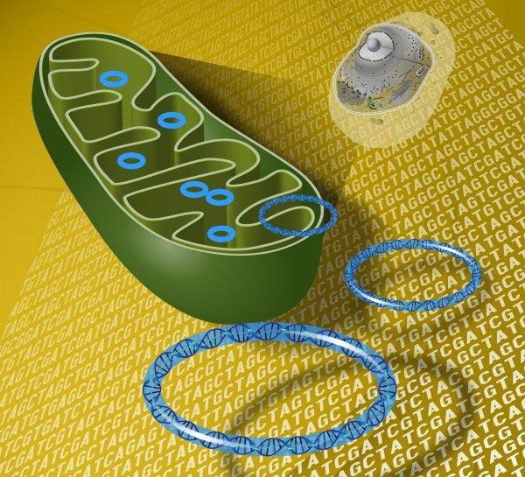
Mitochondrial DNA

Slide 45
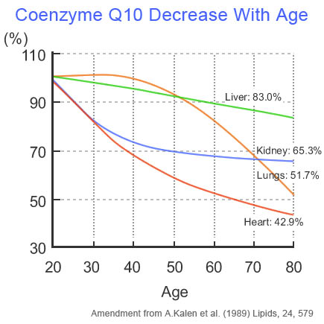
Nutrient Deficiencies

Slide 46
Making Energy
ATP
Protection

Slide 47
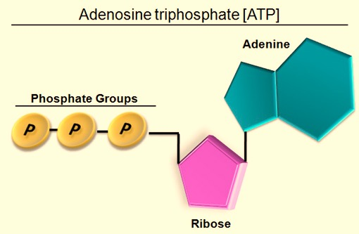
ATP

Slide 48
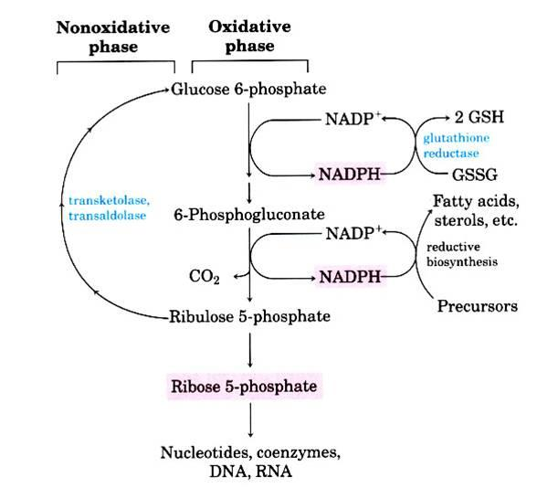
Pentose Phosphate Pathway
Anaerobic
Anaerobic
Carb
Carb
Fat
Fat

Slide 49
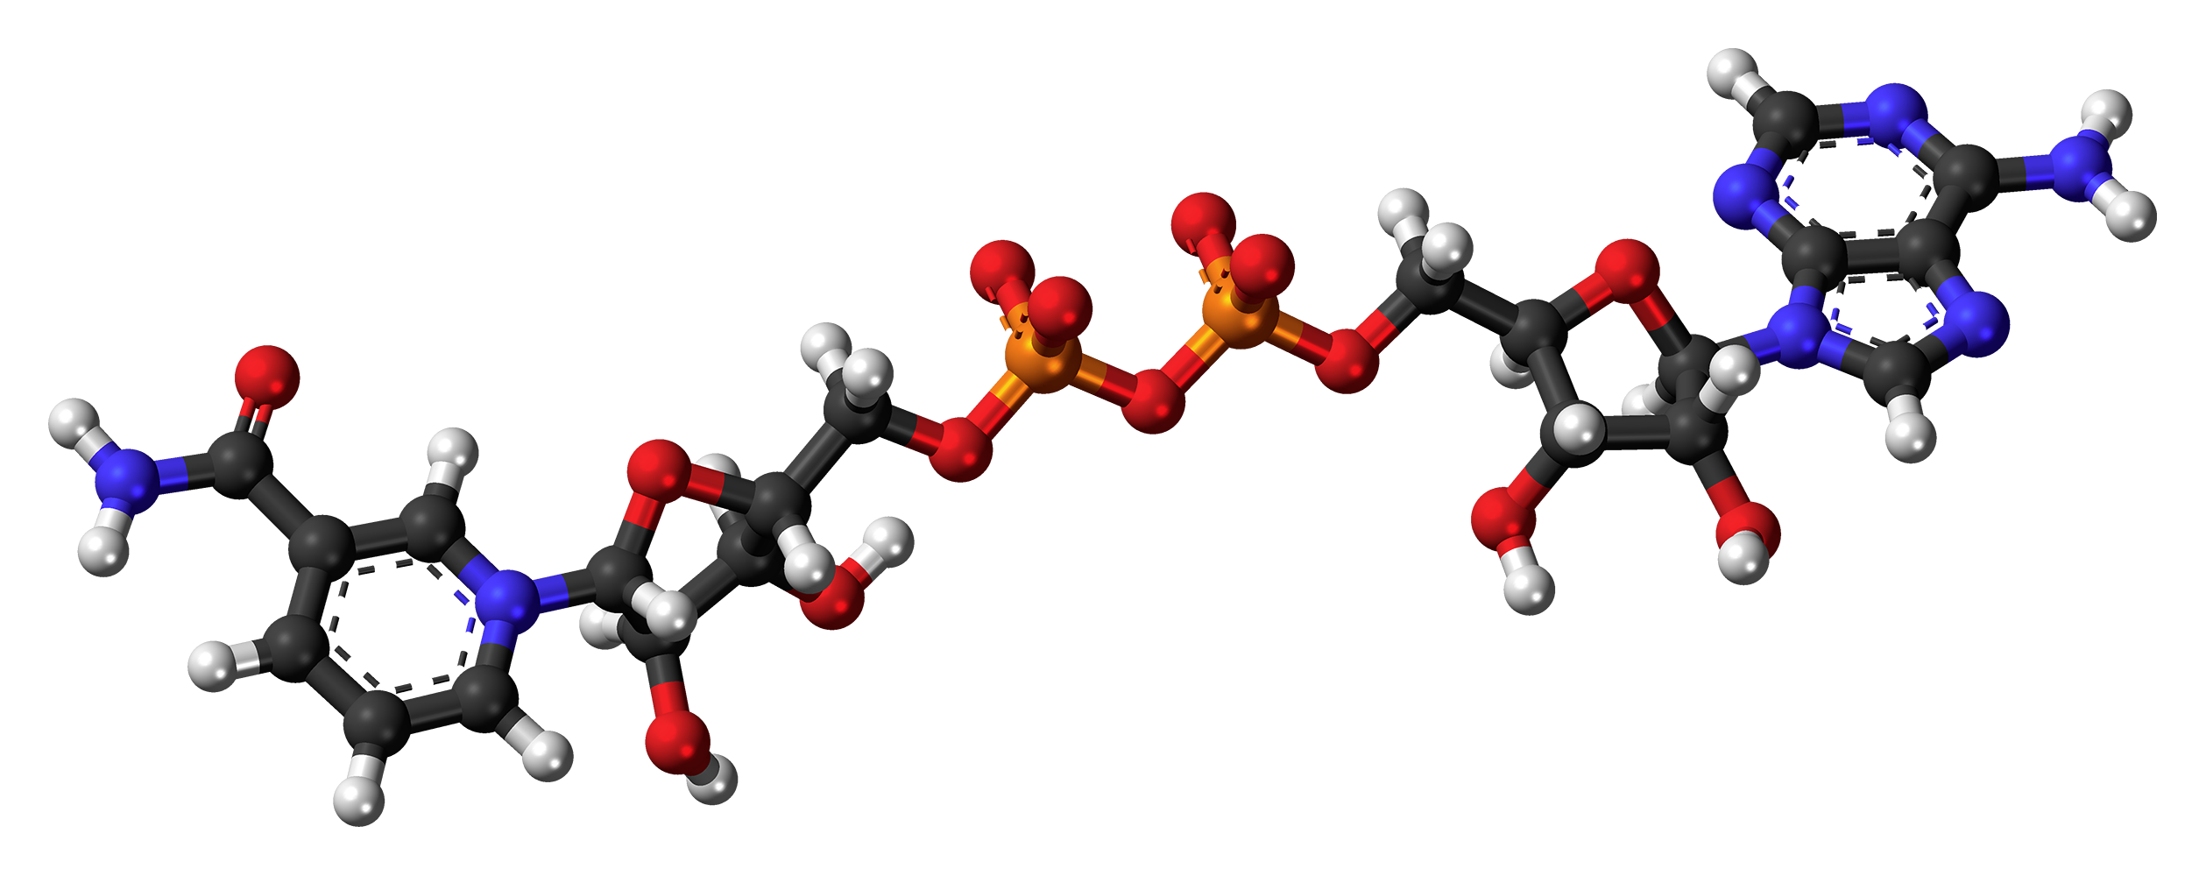
NAD
Pentose Phosphate Pathway
Methylation Pathway
Mitochondrial Pathway
All living cells.

Slide 50
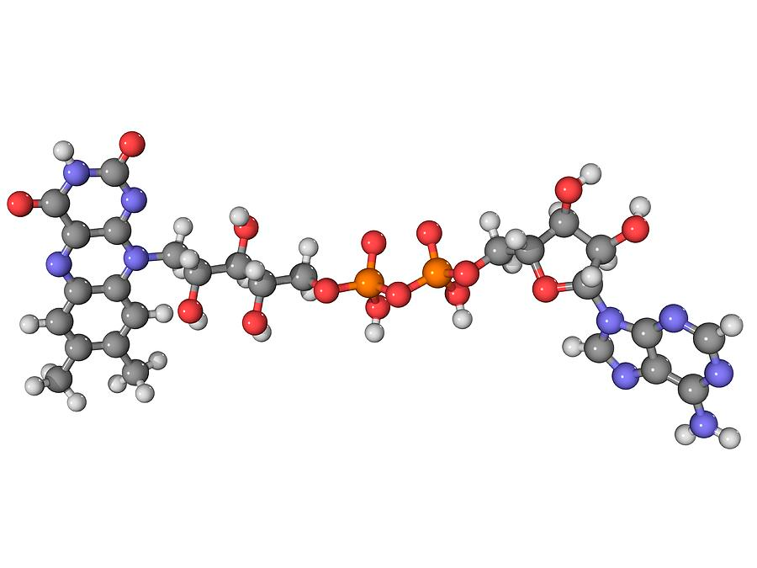
FAD
Electron Acceptor/Donor
Flavin AdenineDineocleotide
Rivoflavin

Slide 51
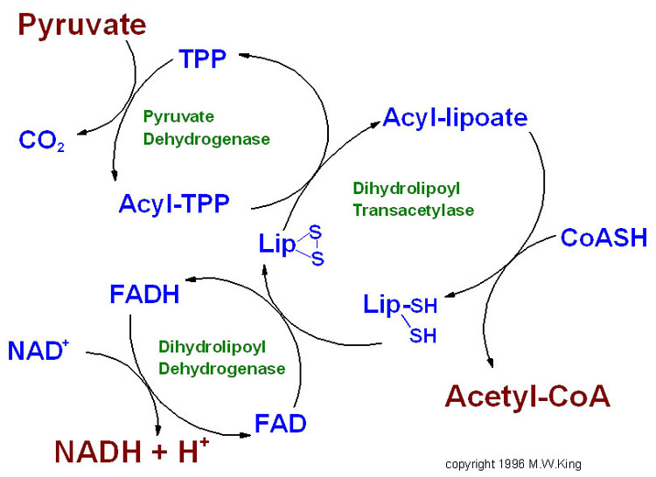
Pyruvate
Thiamine Pyrophosphate

Slide 52
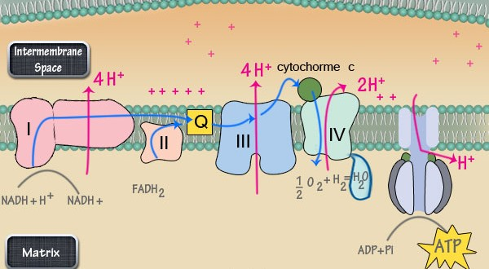
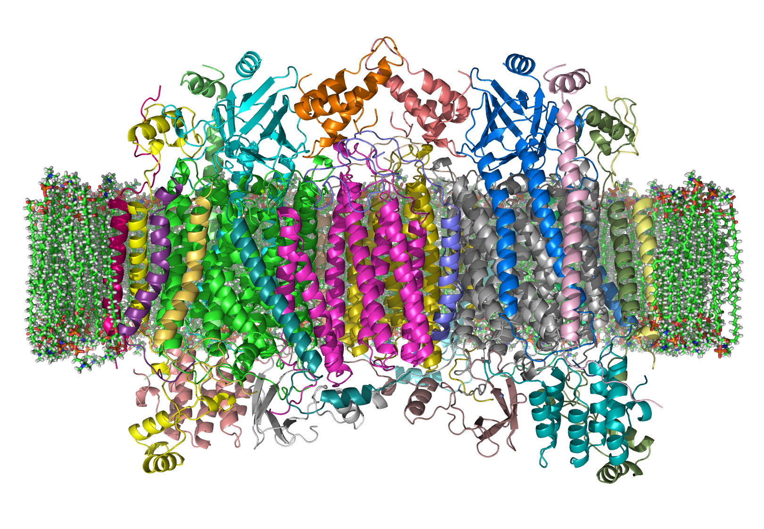
Selenium and Thyroid
Thyroid Hormones
  T4
  T3
  T2
  T1
  T0
Thyroid and Mitochondria

Slide 53
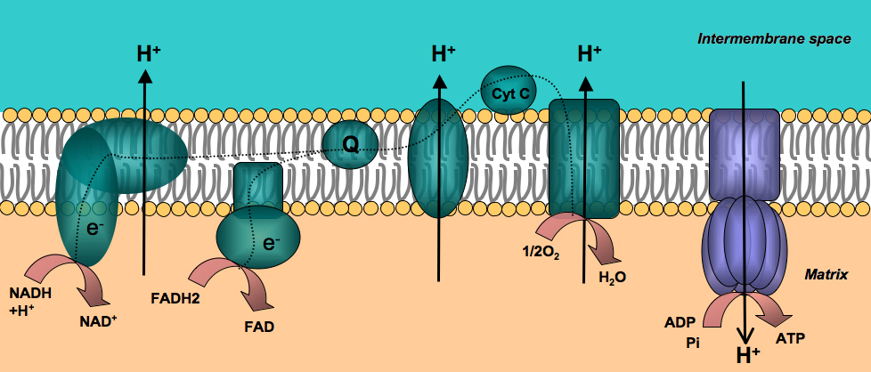
Cytochrome System

Slide 54
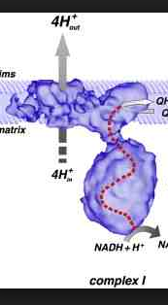
Complex 1
NADH Dehydrogenase
Cofactors needed
  FMN
  NAD
  Iron
  Sulfur
  Co Q10
  Also: Melatonin

Slide 55
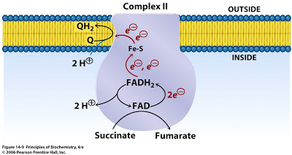
Complex 2
Succinate dehydrogenase
Requires:
FAD
Sulfur
CoQ10
Cardiolipin

Slide 56


Slide 57

Complex 3
Cytochrome C Reductase
Requires
Iron
Sulfur
Stimulated by
Vitamin C
BHB

Slide 58

Complex 4
Cytochrome C Oxidase
  Rate limiting step
Requires
  Copper
Inhibited by
  Nitric oxide, Carbon monoxide
  Hydrogen sulfide, Cyanide

Slide 59

Complex 5
ATP Synthase
Requires:
Magnesium

Slide 60
Mitochondrial Protection
Glutathione
Alpha Lipoic Acid
Superoxide Dismutase
Catalase
Coenzyme Q10
Melatonin

Slide 61
Glutathione
Vitamin E – a molecule of Vitamin E has 3 electrons
to share: It can neutralize 3 free radicals at a time.
Vitamin C – has 2 to 5 electrons to share:
It can neutralize 2 to 5 free radicals at a time.
Glutathione – has 1 million electrons to share:
It can neutralize 1 million free radicals at a time,
as well as give back the lost electrons of exogenous antioxidants
like Vitamin C and Vitamin E making them functional again

Slide 62

Alpha Lipoic Acid

Slide 63
External antioxidants
Vitamin A
Vitamin E
Manganese
Copper
Pycnogenol
Selenium
Turmeric (curcuminoids)
Phytonutrients

Slide 64
Pyrroloquinoline Quinone (PQQ)
Reverses oxidative damage
Stimulates Nerve growth factor
Stimulates ATP Production
Protects against the self-oxidation of the DJ-1 gene, an early step in the onset of Parkinson’s disease
Protects against damage from strokes
Blocks iNOS
Prevents stroke %
Protects against neurotoxicity:
  mercury
  glutamate
  oxidopamine (a neurotoxin used by scientists to induce Parkinsonism in laboratory animals).
Protects nerve cells from the damaging effects of the beta-amyloid-protein
  Alzheimer’s disease.

Slide 65
Rucker R, Chowanadisai W, Nakano M. Potential physiological importance of pyrroloquinoline quinone. Altern Med Rev. 2009 Sep;14(3):268-77.
2. Ohwada K, Takeda H, Yamazaki M, et al. Pyrroloquinoline quinone (PQQ) prevents cognitive deficit caused by oxidative stress in rats. J
Clin Biochem Nutr 2008;42:29-34.
3. Nunome K, Miyazaki S, Nakano M, Iguchi-Ariga S, Ariga H. Pyrroloquinoline quinone prevents oxidative stress-induced neuronal death probably through changes in oxidative status of DJ-1. Biol Pharm Bull. 2008 Jul;31(7):1321-6.
4. Zhang Y, Feustel PJ, Kimelberg HK. Neuroprotection by pyrroloquinoline quinone (PQQ) in reversible middle cerebral artery occlusion in the adult rat. Brain Res 2006;1094:200-206.
5. Hirakawa A, Shimizu K, Fukumitsu H, Furukawa S. Pyrroloquinoline quinone attenuates iNOS gene expression in the injured spinal cord. Biochem Biophys Res Commun 2009;378:308-312.
6. Jensen FE, Gardner GJ, Williams AP, et al. The putative essential nutrient pyrroloquinoline quinone is neuroprotective in a rodent model of hypoxic/ ischemic brain injury. Neuroscience 1994;62:399-406.
7. Zhang P, Xu Y, Sun J, et al. Protection of pyrroloquinoline quinone against methylmercury- induced neurotoxicity via reducing oxidative stress. Free Radic Res 2009;43:224-233.
8. Zhang Q, Shen M, Ding M, Shen D, Ding F. The neuroprotective action of pyrroloquinoline quinone against glutamate-induced apoptosis in hippocampal neurons is mediated through the activation of PI3K/Akt pathway. Toxicol Appl Pharmacol. 2011 Apr 1;252(1):62-72.
9. Kim J, Harada R, Kobayashi M, Kobayashi N, Sode K. The inhibitory effect of pyrroloquinoline quinone on the amyloid formation and cytotoxicity of truncated alpha-synuclein. Mol Neurodegener. 2010 May 20;5:20
10. Kim J, Kobayashi M, Fukuda M, et al. Pyrroloquinoline quinone inhibits the fibrillation of amyloid proteins. Prion. 2010 Jan;4(1):26-31.

Slide 66

Food
Food with color

Slide 67





Full Mito Package
D-Ribose
Ubiquinol

Slide 68
Optimal Mitochondrial Health
Correct
Heart
Lungs
Arteries
Cell membranes
Stress
Remove toxins
Remove infectious agents
Balance hormones
Provide mitochondrial nutrients
Increase endogenous antioxidants
Increase exogenous antioxidants
Eat for mitochondrial health

Slide 69
Glucose
Glucose
Cori Cycle
Liver
Fats
Glycolysis
NAD
2 ATP + Lactic acid
Pyruvate
Hexokinase
Inflammation
Tryglycerides
TPP
NAD
Carnitine
Beta oxidation
Krebs
cycle
CO2
NAD
Ketones
NAD
ATP + CO2
A-CoA
B1, B2, B3 B6 Folate
TMG, Iron, Zinc, Sulfur
Melatonin, Lipoic acid,
CoQ10, Magnesium, Selenium
A-CoA
Lungs
Heart
Arteries
Cell Membranes
O2 + NAD >> ATP
Adrenal
Thyroid
TFA’s, cyanocobalamin, folic acid
Heavy metals, chemicals, stress, age,
lack of exercise, junk food, drugs

Slide 70
An Ode to Mitochondria
Mitochondria, oh mitochondria, how you take care of
Me.
Chloroplasts, like mitochondria, take care of the plants
And the trees.
When I’m feeling low and a little bit irate. You take care of me by adding another phosphate.
I will take care of your needs and do the most,
I’ll eat well, take proper nutrients and be a good host.
Mitochondria, oh mitochondria: Before you
We had a bacterial stew.
Love your mitochondria every moment of every day.
You will feel so good you will want to expand your chest and bray
Is what you are about to do in your mitochondrial best interest?
If it is, you will always be your best and never listless.

