Slide 1
Peripheral neuropathy/
BEMER Therapy RESULTS
From the Liebman Wellness Center
Dr. Jesse Liebman, DC
Dr. Derek Bruno, DC

Slide 2
The patient’s initial exam: 9/10/15
During the initial evaluation, the skin condition was so deteriorated that the patient had to wrap his legs in 10+ layers of gauze and wear multiple socks to keep them from oozing through the bandages.
The patient was unable to balance on his own, move from a seated to standing position, or sit still without a relentless itching sensation.
He had been told that nothing would ever change the state of his skin or his legs.

Slide 3
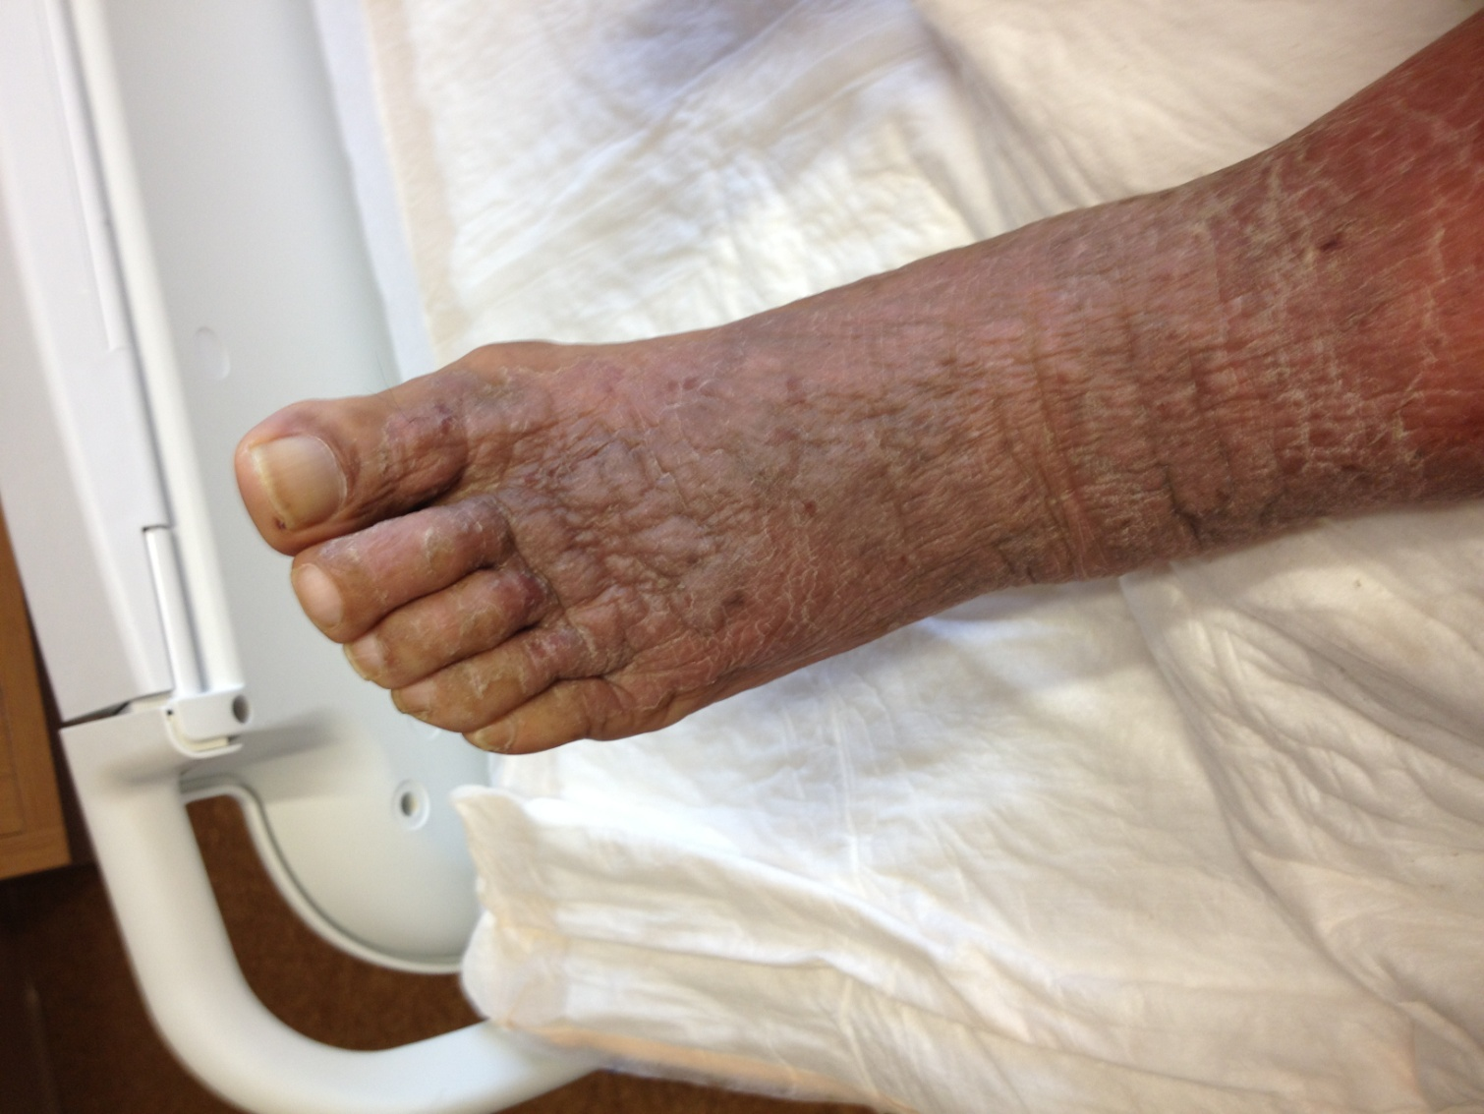
Before Bemer and Peripheral Neuropathy Treatment:
Chronic Itching

Slide 4
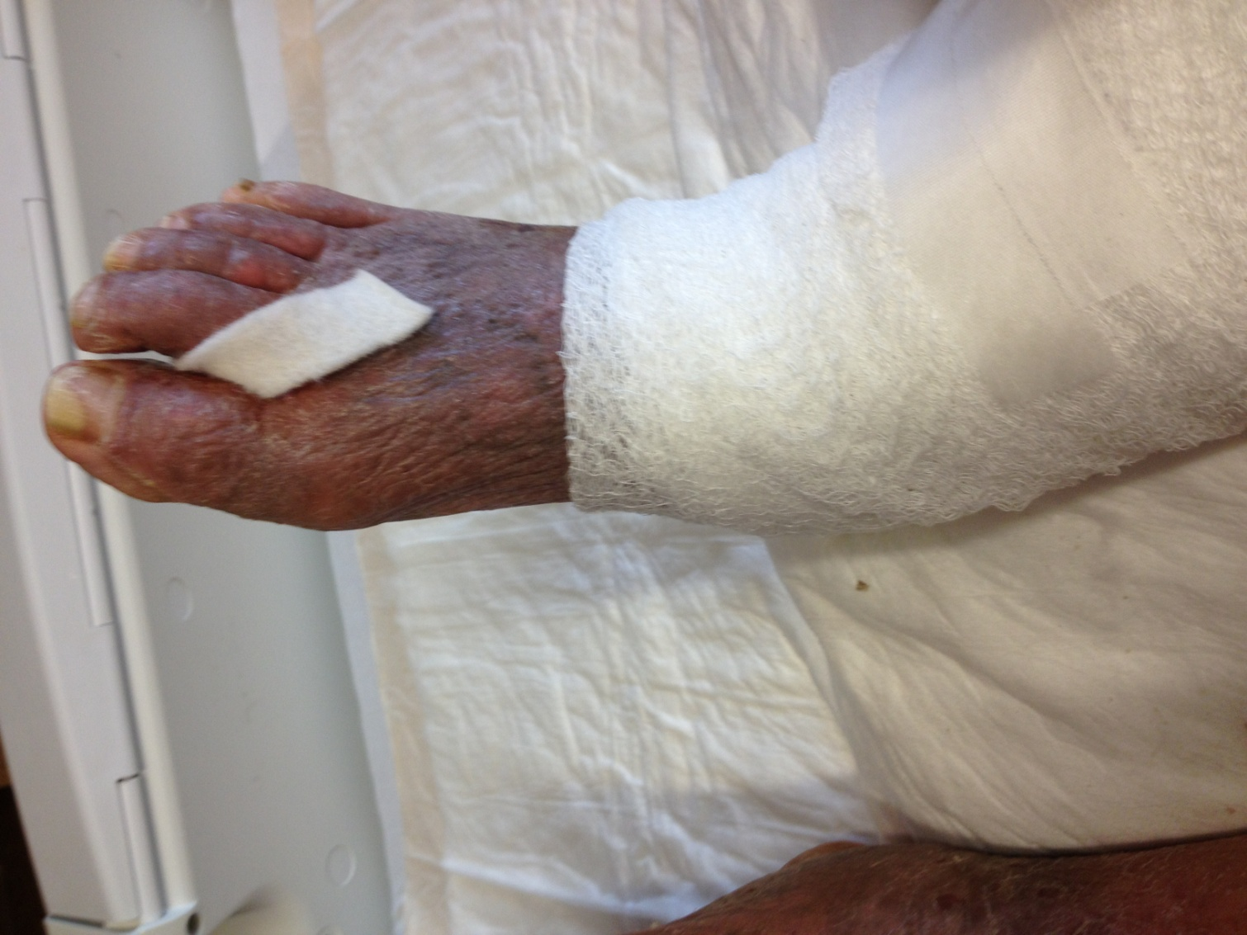
Before: Oozing Skin

Slide 5
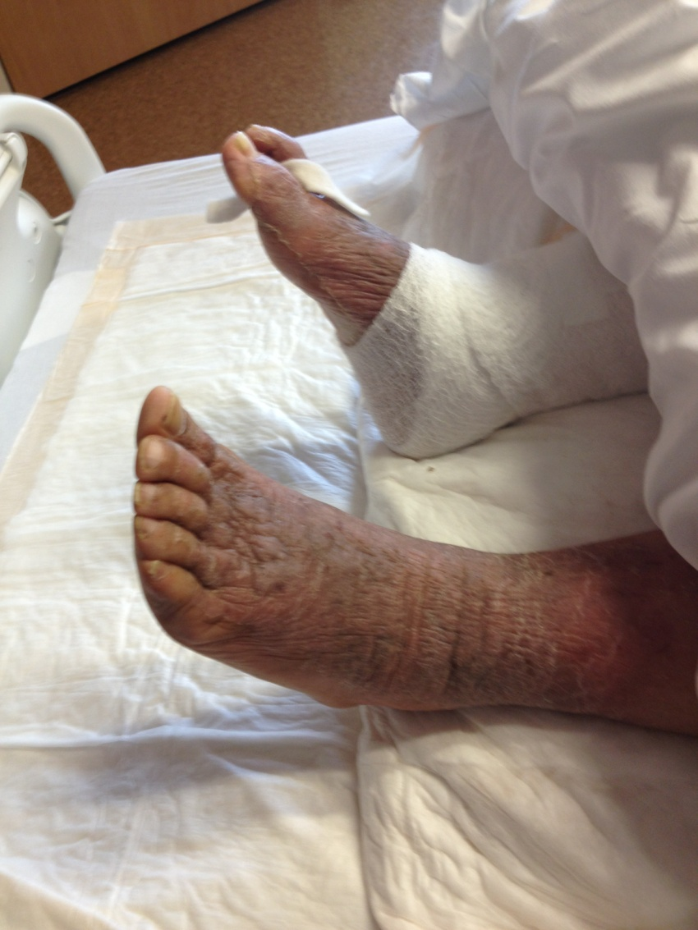
Before: No Balance

Slide 6
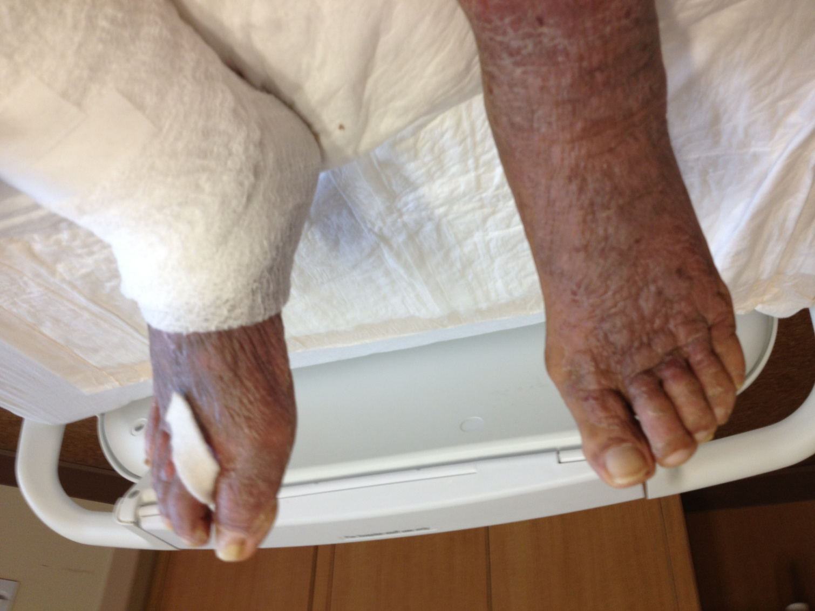
Before: No quality of life

Slide 7
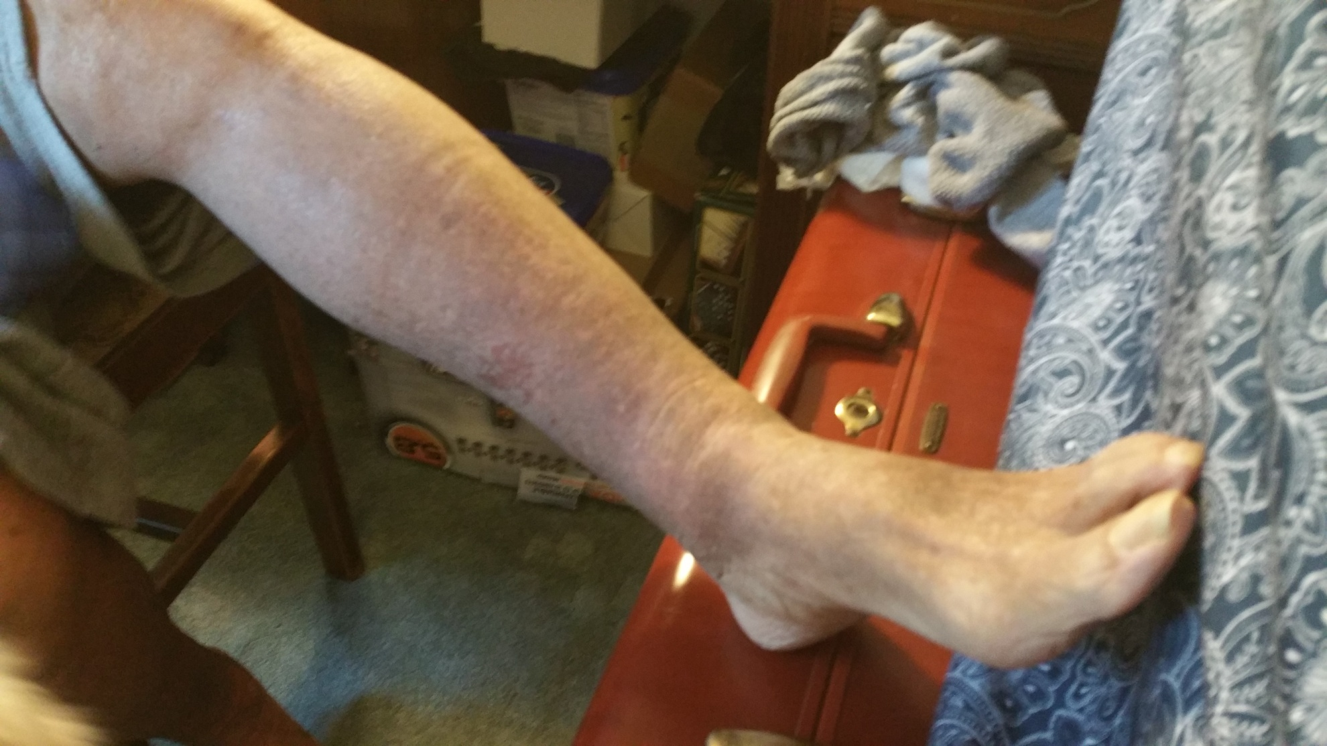
From 9/10/15 to 12/10/15
(After Treatment Pictures)

Slide 8
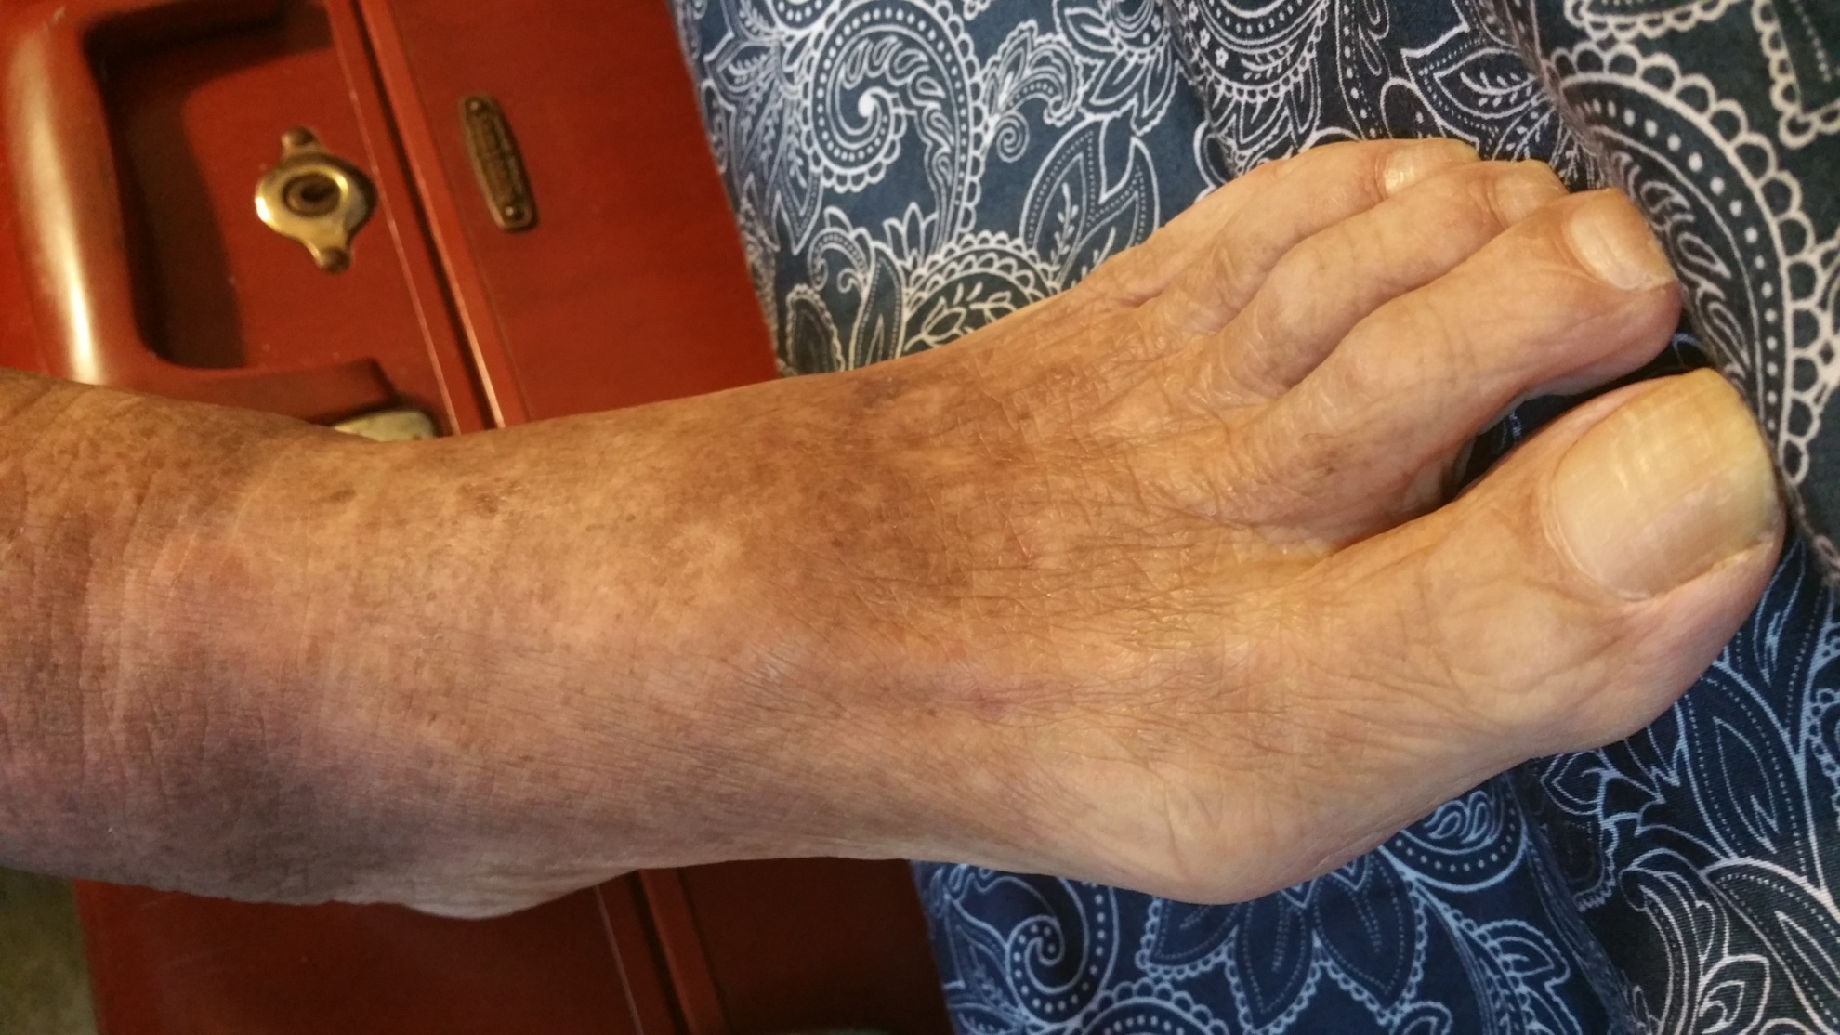
After:
Skin coloration normalized

Slide 9
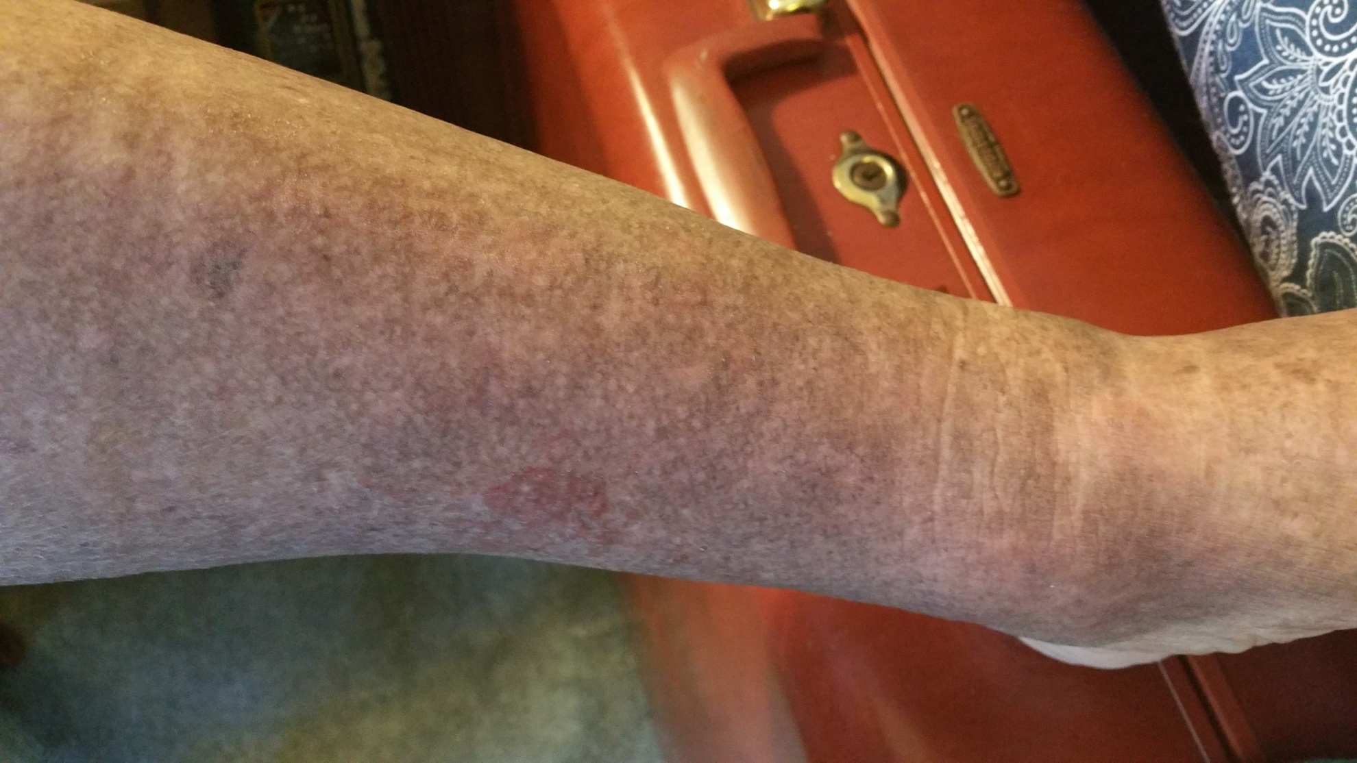
After: cracking and oozing ceased

Slide 10
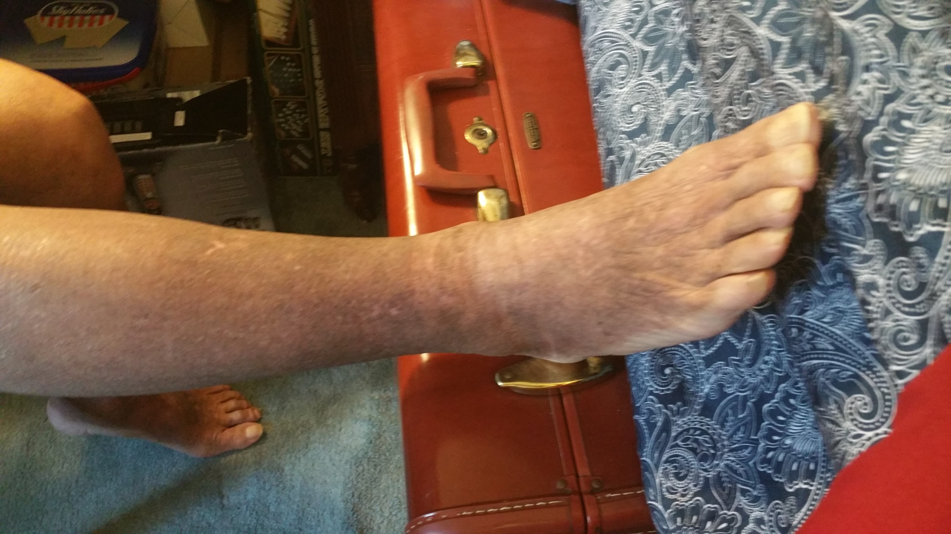
After: Balance returned and itching vanished

